Slide 1
Query Optimization With MySQL 8.0 and MariaDB 10.3:
The Basics
Jaime Crespo
Percona Live Europe 2018
-Frankfurt, 5 Nov 2018-
dbahire.com/pleu18

Slide 2
Agenda
1. Introduction | 6. Joins
2. Query Profiling | 7. Subqueries
3. Access Types and Basic Indexing Techniques | 8. FULLTEXT, Geodata Search and JSON support
4. Multi-Column Indexing | 9. Conclusions
5. Break

Slide 3
Introduction
Query Optimization with MySQL 8.0 and MariaDB 10.3: The Basics

Slide 4


This is me fighting bad query performance
Sr. Database Administrator at Wikimedia Foundation
Used to work as a trainer for Oracle (MySQL), as a Consultant (Percona) and as a Freelance administrator (DBAHire.com)

Slide 5
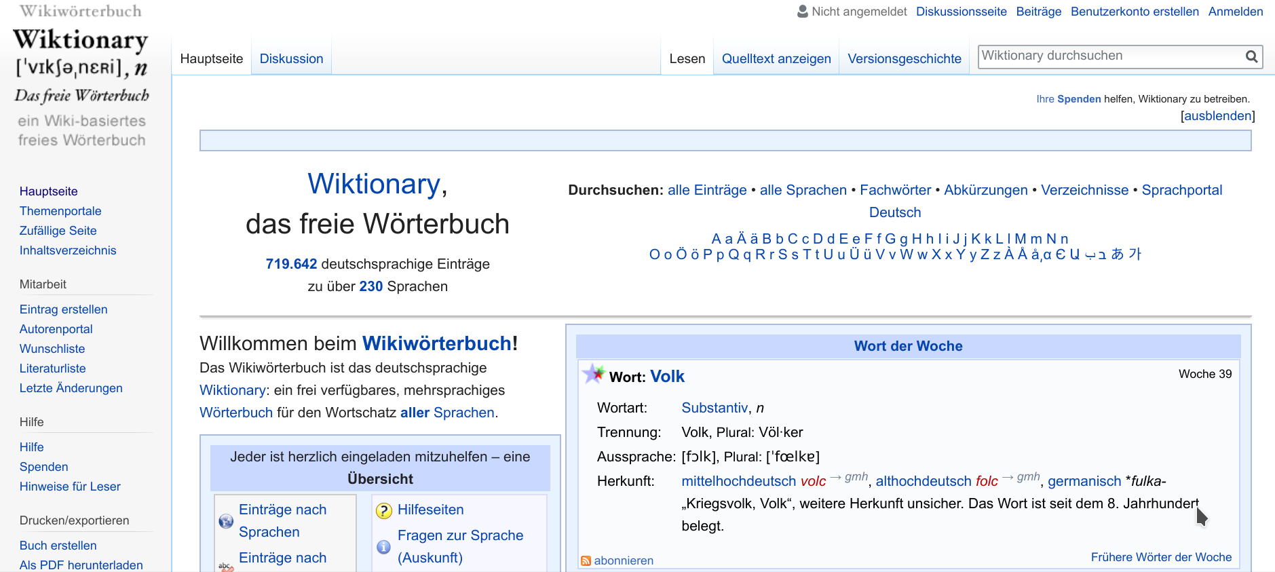
Example Application (I)
Wiktionary (and all Wikimedia projects’ data) is licensed under the Creative Commons BY-SA-3.0 License and is Copyright its Contributors
Notes:
Let’s show a bit around the database.

Slide 6
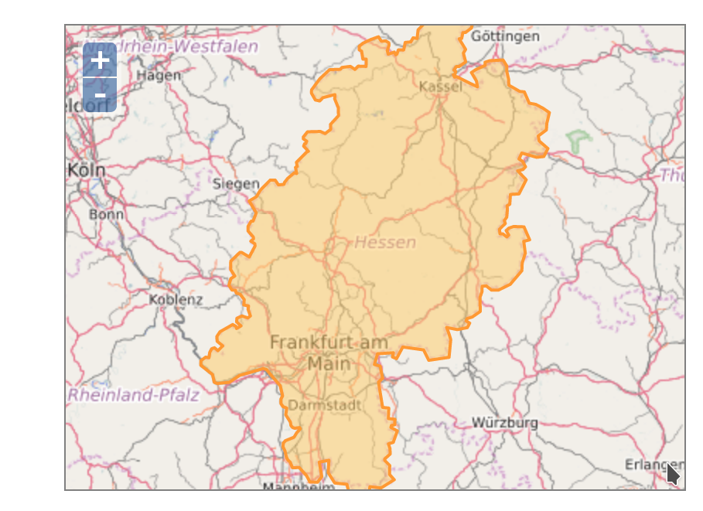
Example Application (II)
OSM Database is licensed under the Open DataBase License and is Copyright OpenStreetMap Contributors
Notes:
Let’s show a bit around the database.

Slide 7
Install the example databases
Downloads and instructions at:
http://dbahire.com/pleu18
  Requirements: a MySQL 8.0 or MariaDB 10.3 installation
  The Wiktionary and OSM extracts
Import them by doing:
$ tar xf <file> && cd <dir> && myloader -d .

Slide 8
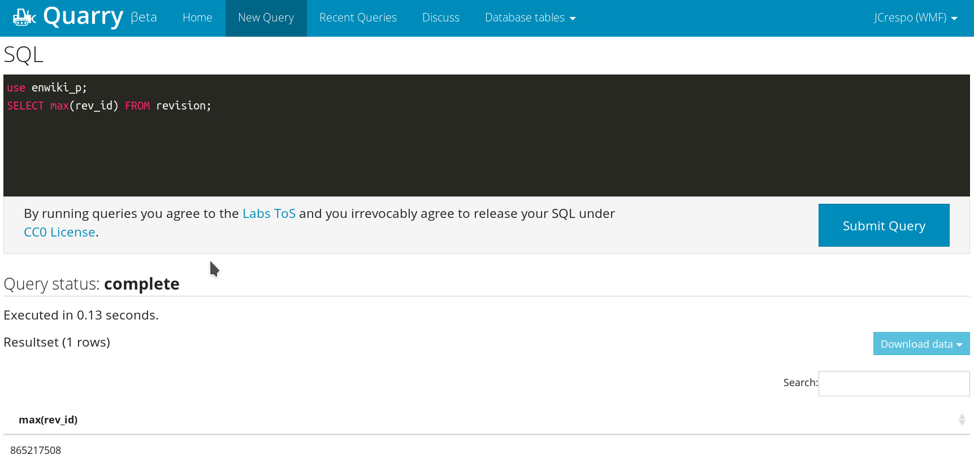
Alternative: Query the Live Database
https://quarry.wmflabs.org/

Slide 9
Query Profiling
Query Optimization with MySQL 8.0 and MariaDB 10.3: The Basics

Slide 10
Which Queries Should I Optimize First?
Tools:
  Application-level profiling
  General monitoring metrics (CPU, IO, etc.)
  Aggregated PROCESSLIST
  pt-query-digest
  PERFORMANCE_SCHEMA
They are not exclusive to each other

Slide 11
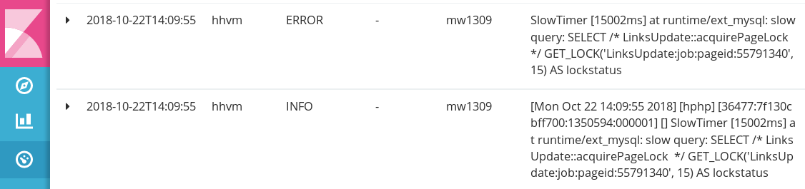
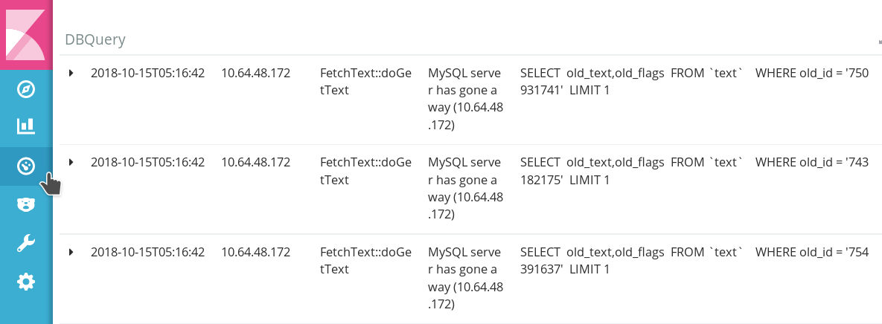
Application-Level profiling

Slide 12
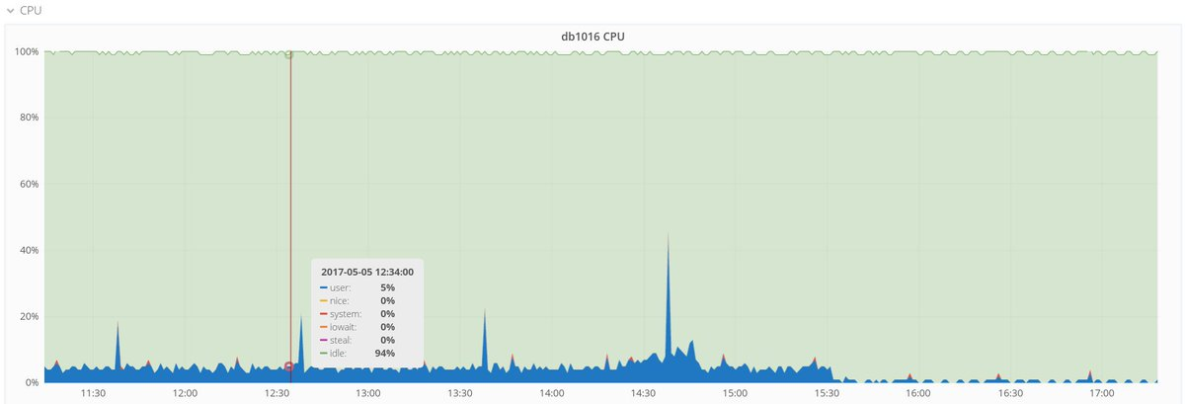
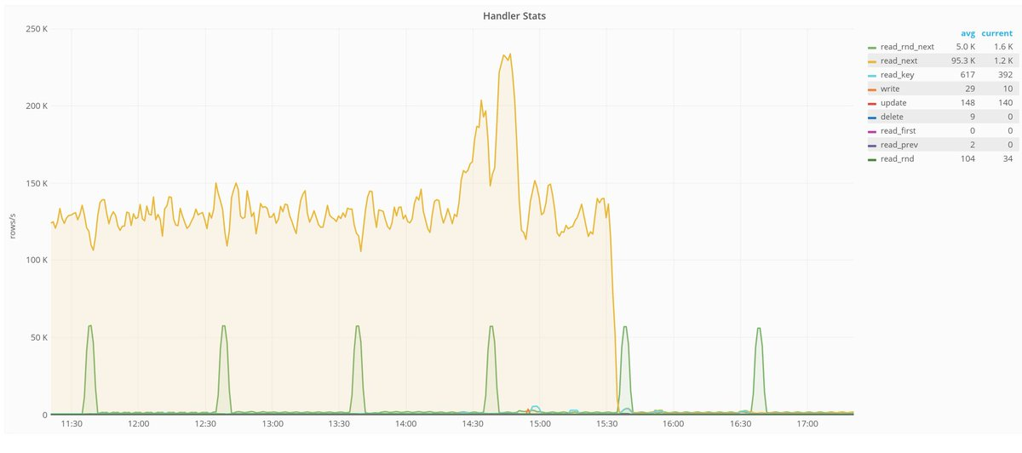
General Monitoring Metrics
New index added at 15:30h

Slide 13
pt-query-digest
It is a 3rd party tool written in Perl, originally created by Baron Schwartz
It requires activation of the slow log:
  SET GLOBAL slow_query_log = 1;
  SET long_query_time = 0;
In Percona Server and MariaDB it can provide extra information:
  SHOW GLOBAL VARIABLES like 'log_slow_verbosity';
Be careful with extra IO and latency!

Slide 14
pt-query-digest Execution (I)
# 1094.7s user time, 9.4s system time, 141.22M rss, 205.21M vsz
# Current date: Wed Jul 1 07:32:28 2015
# Hostname: db1018
# Files: STDIN
# Overall: 4.66M total, 640 unique, 53.47 QPS, 0.02x concurrency _________
# Time range: 2015-06-30 07:00:10 to 2015-07-01 07:11:37
# Attribute total min max avg 95% stddev median
# ============ ======= ======= ======= ======= ======= ======= =======
# Exec time 1320s 1us 3s 283us 332us 3ms 152us
# Lock time 238s 0 13ms 51us 93us 39us 52us
# Rows sent 5.02M 0 4.16k 1.13 1.96 8.69 0.99
# Rows examine 9.50M 0 232.93k 2.14 3.89 261.15 0.99
# Merge passes 0 0 0 0 0 0 0
# Query size 1.06G 17 67.89k 243.89 511.45 368.99 192.76
# Boolean:
# Filesort 8% yes, 91% no
# Full scan 94% yes, 5% no
# Priority que 3% yes, 96% no
# Tmp table 29% yes, 70% no
# Tmp table on 1% yes, 98% no
Actual execution on Wikipedia production servers

Slide 15
pt-query-digest Execution (II)
# Profile
# Rank Query ID Response time Calls R/Call V/M Item
# ==== ================== ============== ======= ====== ===== ============
# 1 0xSANITIZED 242.2765 18.4% 691005 0.0004 0.00 SELECT revision page user
# 2 0xSANITIZED 204.7052 15.5% 80863 0.0025 0.01 SELECT revision page user
# 3 0xSANITIZED 162.8476 12.3% 1025179 0.0002 0.00 SELECT page
# 4 0xSANITIZED 68.1164 5.2% 93928 0.0007 0.01 SELECT revision page user
# 5 0xSANITIZED 66.8302 5.1% 354562 0.0002 0.00 SELECT page revision
# 6 0xSANITIZED 57.0374 4.3% 211631 0.0003 0.00 SELECT page revision
# 7 0xSANITIZED 44.0751 3.3% 6925 0.0064 0.07 SELECT page categorylinks category
# 8 0xSANITIZED 35.0655 2.7% 9689 0.0036 0.00 SELECT text
# 9 0xSANITIZED 29.4363 2.2% 152259 0.0002 0.00 SELECT page
# 10 0xSANITIZED 24.1864 1.8% 176927 0.0001 0.00 SELECT msg_resource
# 11 0xSANITIZED 23.7016 1.8% 144807 0.0002 0.00 SELECT page_restrictions
# 12 0xSANITIZED 16.6547 1.3% 10135 0.0016 0.03 SELECT revision
# 13 0xSANITIZED 15.0564 1.1% 263809 0.0001 0.00 SET

Slide 16
pt-query-digest Execution (III)
# Query 1: 7.93 QPS, 0.00x concurrency, ID 0xSANITIZED at byte 1553864032
# This item is included in the report because it matches –limit.
# Scores: V/M = 0.00
# Time range: 2015-06-30 07:00:10 to 2015-07-01 07:11:37
# Attribute pct total min max avg 95% stddev median
# ============ === ======= ======= ======= ======= ======= ======= =======
# Count 14 691005
# Exec time 18 242s 163us 91ms 350us 348us 563us 301us
# Lock time 26 63s 47us 7ms 91us 103us 14us 84us
# Rows sent 12 657.18k 0 1 0.97 0.99 0.16 0.99
# Rows examine 6 657.18k 0 1 0.97 0.99 0.16 0.99
# Query size 31 345.42M 501 749 524.16 537.02 9.22 511.45
# String:
# Databases itwiki (225976/32%), enwiktiona... (219461/31%)... 15 more
# Hosts
# Users wikiuser
# Query_time distribution
# 1us
# 10us
# 100us ################################################################
# 1ms #
# 10ms #
# 100ms
# 1s
# 10s+
# Tables
# SHOW TABLE STATUS FROM `enwiktionary` LIKE 'revision'\G
# SHOW CREATE TABLE `enwiktionary`.`revision`\G
# SHOW TABLE STATUS FROM `enwiktionary` LIKE 'page'\G
# SHOW CREATE TABLE `enwiktionary`.`page`\G
# SHOW TABLE STATUS FROM `enwiktionary` LIKE 'user'\G
# SHOW CREATE TABLE `enwiktionary`.`user`\G
# EXPLAIN /*!50100 PARTITIONS*/
SELECT /* Revision::fetchFromConds SANITIZED */ * FROM `revision`
INNER JOIN `page` ON ((page_id = rev_page)) LEFT JOIN `user` ON
((rev_user != 0) AND (user_id = rev_user)) WHERE page_namespace = '0' AND
page_title = 'SANITIZED' AND (rev_id=page_latest) LIMIT 1\G

Slide 17
PERFORMANCE_SCHEMA
Monitoring schema (engine) enabled by default since MySQL 5.6
  performance_schema = 1 (it is not dynamic)
Deprecates the old query profiling
It is way more user-friendly when combined with the SYS schema/ps_helper (a set of views and stored procedures created by Mark Leith)
  Included by default since 5.7.7

Slide 18
Installation of the SYS Schema <5.7/MariaDB
$ git clone https://github.com/MarkLeith/mysql-sys.git
Cloning into 'mysql-sys'...
remote: Counting objects: 926, done.
remote: Compressing objects: 100% (73/73), done.
remote: Total 926 (delta 35), reused 6 (delta 2)
Receiving objects: 100% (926/926), 452.19 KiB | 225.00 KiB/s, done.
Resolving deltas: 100% (584/584), done.
$ cd mysql-sys/
$ mysql < sys_56.sql

Slide 19
Example Usage: Discovering Unused Indexes
mysql (osm) > SELECT * FROM sys.schema_unused_indexes LIMIT 5;
+---------------+-------------------+---------------------------------+
| object_schema | object_name | index_name |
+---------------+-------------------+---------------------------------+
| osm | acls | acls_k_idx |
| osm | changeset_tags | changeset_tags_id_idx |
| osm | current_nodes | current_nodes_timestamp_idx |
| osm | current_nodes | current_nodes_tile_idx |
| osm | current_relations | current_relations_timestamp_idx |
+---------------+-------------------+---------------------------------+
5 rows in set (0.04 sec)
mysql-5.7.8 (osm) > SELECT * FROM current_nodes WHERE tile = 100;
...
mysql-5.7.8 (osm) > SELECT * FROM sys.schema_unused_indexes LIMIT 5;
+---------------+-------------------+---------------------------------+
| object_schema | object_name | index_name |
+---------------+-------------------+---------------------------------+
| osm | acls | acls_k_idx |
| osm | changeset_tags | changeset_tags_id_idx |
| osm | current_nodes | current_nodes_timestamp_idx |
| osm | current_relations | current_relations_timestamp_idx |
| osm | current_relations | changeset_id |
+---------------+-------------------+---------------------------------+
5 rows in set (0.03 sec)
With enough activity, it can help us clean up our schema
Notes:
Similar information that we could only previously get with the user_stats plugin in Percona/MariaDB or pt-index-usage

Slide 20
Example Usage: Slow Queries (ordered by server time)
mysql (osm) > SELECT * FROM sys.statement_analysis LIMIT 10\G
*************** 1. row ***************
query: SELECT `way_id` AS `id` , `v` FROM `way_tags` WHERE `v` LIKE ?
db: osm
full_scan: *
exec_count: 15
err_count: 0
warn_count: 0
total_latency: 7.83 s
max_latency: 1.33 s
avg_latency: 521.84 ms
lock_latency: 17.94 ms
rows_sent: 6779
rows_sent_avg: 452
rows_examined: 20152155
rows_examined_avg: 1343477
rows_affected: 0
rows_affected_avg: 0
tmp_tables: 0
tmp_disk_tables: 0
rows_sorted: 0
sort_merge_passes: 0
digest: 21f90695b1ebf20a5f4d4c1e5e860f58
first_seen: 2014-11-01 17:04:51
last_seen: 2014-11-01 17:05:22
Notes:
It’s similar information to what we get with Percona Server/MariaDB with the verbose slow log.

Slide 21
Example Usage: Top Queries Creating Temporary Tables
mysql (osm) > SELECT * FROM sys.statements_with_temp_tables WHERE db = 'osm' LIMIT 10\G
*************************** 1. row ***************************
query: SELECT ? AS TYPE , `node_id` A ... gs` WHERE `k` = ? AND `v` = ?
db: osm
exec_count: 11
total_latency: 7.57 s
memory_tmp_tables: 11
disk_tmp_tables: 0
avg_tmp_tables_per_query: 1
tmp_tables_to_disk_pct: 0
first_seen: 2014-11-01 17:33:55
last_seen: 2014-11-01 17:34:45
digest: 5e6e82799b7c7c0e5c57cfe63eb98d5d
Notes:
This is the top query creating temporary tables.

Slide 22
Example Usage: Top Queries Creating Temporary Tables (cont.)
mysql (osm) > SELECT DIGEST_TEXT FROM performance_schema.events_statements_summary_by_digest WHERE digest = '5e6e82799b7c7c0e5c57cfe63eb98d5d'\G
*************************** 1. row ***************************
DIGEST_TEXT: SELECT ? AS TYPE , `node_id` AS `id` FROM `node_tags` WHERE `k` = ? AND `v` = ? UNION SELECT ? AS TYPE , `way_id` AS `id` FROM `way_tags` WHERE `k` = ? AND `v` = ? UNION SELECT ? AS TYPE , `relation_id` AS `id` FROM `relation_tags` WHERE `k` = ? AND `v` = ?
1 row in set (0.00 sec)
mysql-5.7.8 (osm) > EXPLAIN SELECT 'node' as type, node_id as id FROM node_tags WHERE k='amenity' and v='cafe' UNION SELECT 'way' as type, way_id as id FROM way_tags WHERE k='amenity' and v='cafe' UNION SELECT 'relation' as type, relation_id as id FROM relation_tags WHERE k='amenity' and v='cafe';
+----+--------------+---------------+------------+------+---------------+------+---------+------+---------+----------+-----------------+
| id | select_type | table | partitions | type | possible_keys | key | key_len | ref | rows | filtered | Extra |
+----+--------------+---------------+------------+------+---------------+------+---------+------+---------+----------+-----------------+
| 1 | PRIMARY | node_tags | NULL | ALL | NULL | NULL | NULL | NULL | 851339 | 0.00 | Using where |
| 2 | UNION | way_tags | NULL | ALL | NULL | NULL | NULL | NULL | 1331016 | 0.00 | Using where |
| 3 | UNION | relation_tags | NULL | ALL | NULL | NULL | NULL | NULL | 63201 | 0.00 | Using where |
| NULL | UNION RESULT | <union1,2,3> | NULL | ALL | NULL | NULL | NULL | NULL | NULL | NULL | Using temporary |
+----+--------------+---------------+------------+------+---------------+------+---------+------+---------+----------+-----------------+
4 rows in set, 1 warning (0.01 sec)
Notes:
Let’s check the full digest and EXPLAIN it… It looks like the temporary tables it is creating is due to the UNIONs. Can we fix that?

Slide 23
Access Types and Basic Indexing techniques
Query Optimization with MySQL 8.0 and MariaDB 10.3: The Basics
Notes:
It should be 9:30 around here.

Slide 24
EXPLAIN
Essential to understand the execution plan of our queries
  Works on SELECTs, INSERTs, UPDATEs, REPLACEs, DELETEs and connections
  Fully documented on: https://dev.mysql.com/doc/refman/8.0/en/explain-output.html

Slide 25
EXPLAIN Example
MariaDB [dewiktionary]> EXPLAIN SELECT * FROM page WHERE page_title = 'German';
+------+-------------+-------+------+---------------+------+---------+------+--------+-------------+
| id | select_type | table | type | possible_keys | key | key_len | ref | rows | Extra |
+------+-------------+-------+------+---------------+------+---------+------+--------+-------------+
| 1 | SIMPLE | page | ALL | NULL | NULL | NULL | NULL | 778885 | Using where |
+------+-------------+-------+------+---------------+------+---------+------+--------+-------------+
1 row in set (0.00 sec)
Difficult to see something

Slide 26
EXPLAIN Example (vertical format)
MariaDB [dewiktionary]> EXPLAIN SELECT * FROM page WHERE page_title = 'German'\G
*************************** 1. row ***************************
id: 1
select_type: SIMPLE
table: page
type: ALL
possible_keys: NULL
key: NULL
key_len: NULL
ref: NULL
rows: 778885
Extra: Using where
1 row in set (0.00 sec)
Use \G for vertical formatting

Slide 27
EXPLAIN Example (id)
MariaDB [dewiktionary]> EXPLAIN SELECT * FROM page WHERE page_title = 'German'\G
*************************** 1. row ***************************
id: 1
select_type: SIMPLE
table: page
type: ALL
possible_keys: NULL
key: NULL
key_len: NULL
ref: NULL
rows: 778885
Extra: Using where
1 row in set (0.00 sec)
Indicates nesting level, not execution order

Slide 28
EXPLAIN Example (select_type)
MariaDB [dewiktionary]> EXPLAIN SELECT * FROM page WHERE page_title = 'German'\G
*************************** 1. row ***************************
id: 1
select_type: SIMPLE
table: page
type: ALL
possible_keys: NULL
key: NULL
key_len: NULL
ref: NULL
rows: 778885
Extra: Using where
1 row in set (0.00 sec)
Not a subquery or a UNION

Slide 29
EXPLAIN Example (table)
MariaDB [dewiktionary]> EXPLAIN SELECT * FROM page WHERE page_title = 'German'\G
*************************** 1. row ***************************
id: 1
select_type: SIMPLE
table: page
type: ALL
possible_keys: NULL
key: NULL
key_len: NULL
ref: NULL
rows: 778885
Extra: Using where
1 row in set (0.00 sec)
Table scanned for this step

Slide 30
EXPLAIN Example (type)
MariaDB [dewiktionary]> EXPLAIN SELECT * FROM page WHERE page_title = 'German'\G
*************************** 1. row ***************************
id: 1
select_type: SIMPLE
table: page
type: ALL
possible_keys: NULL
key: NULL
key_len: NULL
ref: NULL
rows: 778885
Extra: Using where
1 row in set (0.00 sec)
All rows are read for this table (FULL TABLE SCAN)

Slide 31
EXPLAIN Example (rows)
MariaDB [dewiktionary]> EXPLAIN SELECT * FROM page WHERE page_title = 'German'\G
*************************** 1. row ***************************
id: 1
select_type: SIMPLE
table: page
type: ALL
possible_keys: NULL
key: NULL
key_len: NULL
ref: NULL
rows: 778885
Extra: Using where
1 row in set (0.00 sec)
Estimated number of rows to be read (all table rows)

Slide 32
How to improve performance?
MariaDB [dewiktionary]> SELECT * FROM page WHERE page_title = 'German';
1 row in set (0.10 sec)
Let's add an index on page.page_title:
MariaDB [dewiktionary]> ALTER TABLE page ADD INDEX page_title (page_title);
Query OK, 0 rows affected (22.70 sec)
Records: 0 Duplicates: 0 Warnings: 0

Slide 33
Index creation results (type)
MariaDB [dewiktionary]> EXPLAIN SELECT * FROM page WHERE page_title = 'German'\G
*************************** 1. row ***************************
id: 1
select_type: SIMPLE
table: page
type: ref
possible_keys: page_title
key: page_title
key_len: 257
ref: const
rows: 1
Extra: Using index condition
1 row in set (0.00 sec)
type: ref means that an equality comparison will be checked against an index and several results could be returned

Slide 34
Index creation results (possible_keys and key)
MariaDB [dewiktionary]> EXPLAIN SELECT * FROM page WHERE page_title = 'German'\G
*************************** 1. row ***************************
id: 1
select_type: SIMPLE
table: page
type: ref
possible_keys: page_title
key: page_title
key_len: 257
ref: const
rows: 1
Extra: Using index condition
1 row in set (0.00 sec)
index(es) that the optimizer considered potentially useful, and final index chosen

Slide 35
Index creation results (ref)
MariaDB [dewiktionary]> EXPLAIN SELECT * FROM page WHERE page_title = 'German'\G
*************************** 1. row ***************************
id: 1
select_type: SIMPLE
table: page
type: ref
possible_keys: page_title
key: page_title
key_len: 257
ref: const
rows: 1
Extra: Using index condition
1 row in set (0.00 sec)
Index is compared with a constant, not with another table

Slide 36
Index creation results (rows)
MariaDB [dewiktionary]> EXPLAIN SELECT * FROM page WHERE page_title = 'German'\G
*************************** 1. row ***************************
id: 1
select_type: SIMPLE
table: page
type: ref
possible_keys: page_title
key: page_title
key_len: 257
ref: const
rows: 1
Extra: Using index condition
1 row in set (0.00 sec)
Only 1 row read. In this case, estimation is exact (thanks to index dive)

Slide 37
Index creation results (query time)
MariaDB [dewiktionary]> SELECT * FROM page WHERE page_title = 'German';
1 row in set (0.00 sec)
Query time has been reduced substantially

Slide 38
Types of indexes
BTREE
  B-TREE in MyISAM, B+TREE in InnoDB
HASH
  Only available for MEMORY and NDB
FULLTEXT
  Inverted indexes in MyISAM and InnoDB
SPATIAL
  RTREEs in MyISAM and InnoDB

Slide 39
Finding “German” with a BTREE
Avast
Boss
German
Goal
Etch
Golf
Iceberg
Harlem
TABLE
Landscape
Leek
Nasty
Maelstrom
School
Rover
Walrus
Notes:
Remember these diagrams are very simplified versions of the different MySQL’s engine implementations, for an in depth InnoDB internals visualization, go to https://www.percona.com/live/mysql-conference-2013/sessions/innodb-journey-core

Slide 40
Finding “German” with a BTREE
Avast
Boss
German
Goal
Etch
Golf
Iceberg
Harlem
TABLE
Landscape
Leek
Nasty
Maelstrom
School
Rover
Walrus

Slide 41
Do indexes always work? (1/2)
Can we use an index to make this query faster?
SELECT * FROM page WHERE page_title like 'Spa%';

Slide 42
It is a range
MariaDB [dewiktionary]> EXPLAIN SELECT * FROM page WHERE page_title like 'Spa%'\G
*************************** 1. row ***************************
id: 1
select_type: SIMPLE
table: page
type: range
possible_keys: page_title
key: page_title
key_len: 257
ref: NULL
rows: 563
Extra: Using index condition
1 row in set (0.00 sec)
Despite not being an equality, we can use the index to find the values quickly

Slide 43
BTREE Indexes can be used for ranges, too
Avast
Boss
Goal
German
Etch
Golf
Iceberg
Harlem
TABLE
Landscape
Leek
Nasty
Maelstrom
School
Rover
Walrus

Slide 44
Do indexes always work? (2/2)
What about this other query?
SELECT * FROM page WHERE page_title like '%erman';

Slide 45
Let's check with EXPLAIN
MariaDB [dewiktionary]> EXPLAIN SELECT * FROM page WHERE page_title like '%erman'\G
*************************** 1. row ***************************
id: 1
select_type: SIMPLE
table: page
type: ALL
possible_keys: NULL
key: NULL
key_len: NULL
ref: NULL
rows: 778885
Extra: Using where
1 row in set (0.00 sec)
No index can be used for filtering. A full table scan is performed.

Slide 46
BTREE Index
Avast
Boss
German
Goal
Etch
Golf
Iceberg
Harlem
TABLE
Landscape
Leek
?
Nasty
Maelstrom
School
Rover
Walrus

Slide 47
Btree indexes usage (I)
Filtering (“WHERE”)
  Equality (operator '=')
  Ranges (BETWEEN … AND, >, <, >=, <=, like 'prefix%')
  “EXISTS” operators: IN, OR on the same column
Ordering
  ORDER BY (indexed columns)
  GROUP BY (indexed columns)

Slide 48
Btree indexes usage (II)
Returning values directly from the index
  Covering index
  Functions like max(), min(), etc.
Reduced contention (writes)
  Locking less rows, increasing concurrency

Slide 49
type: const
MariaDB [dewiktionary]> EXPLAIN SELECT * FROM revision WHERE rev_id = 2\G
*************************** 1. row ***************************
id: 1
select_type: SIMPLE
table: revision
type: const
possible_keys: PRIMARY
key: PRIMARY
key_len: 4
ref: const
rows: 1
Extra:
1 row in set (0.00 sec)
'const' is a special case of 'ref', when the index can assure that only 1 result can be returned (equality + primary key or unique key). It is faster.

Slide 50
type: NULL
MariaDB [dewiktionary]> EXPLAIN SELECT * FROM revision WHERE rev_id = -1\G
*************************** 1. row ***************************
id: 1
select_type: SIMPLE
table: NULL
type: NULL
possible_keys: NULL
key: NULL
key_len: NULL
ref: NULL
rows: NULL
Extra: Impossible WHERE noticed after reading const tables
1 row in set (0.00 sec)
'NULL' is not really a plan, just an optimization that allows immediately discarding impossible conditions

Slide 51
type: ref_or_null
MariaDB [osm]> EXPLAIN SELECT * FROM nodes WHERE tile = 1 or tile is null\G
*************************** 1. row ***************************
id: 1
select_type: SIMPLE
table: nodes
type: ref_or_null
possible_keys: nodes_tile_idx
key: nodes_tile_idx
key_len: 5
ref: const
rows: 2
Extra: Using index condition; Using where
1 row in set (0.00 sec)
Equivalent to 'ref', but also takes into account NULL values

Slide 52
type: range (using IN / OR)
MariaDB [dewiktionary]> EXPLAIN SELECT * FROM page WHERE page_title IN ('German', 'English', 'Spanish')\G
*************************** 1. row ***************************
id: 1
select_type: SIMPLE
table: page
type: range
possible_keys: page_title
key: page_title
key_len: 257
ref: NULL
rows: 4
Extra: Using index condition
1 row in set (0.00 sec)
Despite being a range, its execution is very different from ranges using like, between or inequality operators

Slide 53
Is this a bug? (1/2)
MariaDB [dewiktionary]> EXPLAIN SELECT * FROM page WHERE page_namespace > 200\G
*************************** 1. row ***************************
id: 1
select_type: SIMPLE
table: page
type: ref
possible_keys: name_title
key: name_title
key_len: 4
ref: const
rows: 50
Extra:
1 row in set (0.00 sec)
An index is used to return pages with namespace>200

Slide 54
Is this a bug? (2/2)
MariaDB [dewiktionary]> EXPLAIN SELECT * FROM page WHERE page_namespace < 200\G
*************************** 1. row ***************************
id: 1
select_type: SIMPLE
table: page
type: ALL
possible_keys: name_title
key: NULL
key_len: NULL
ref: NULL
rows: 778885
Extra: Using where
1 row in set (0.00 sec)
The index is not used with ns=0

Slide 55
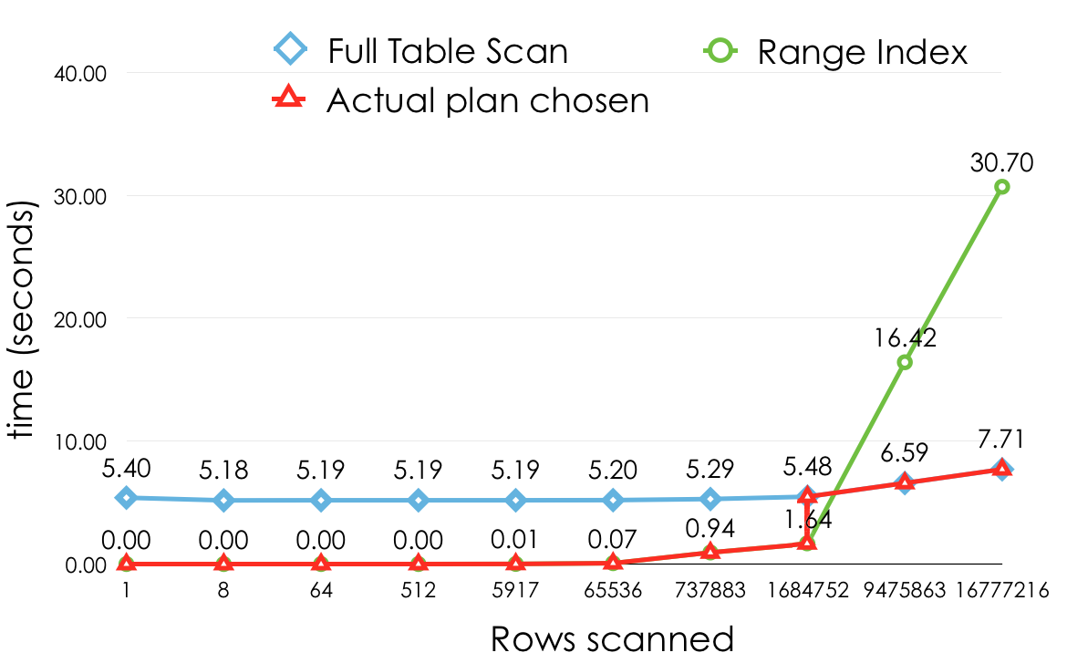
Using an index is sometimes suboptimal
This point is not fixed, and depends on the hardware and buffer state

Slide 56
What index should we add to make this query faster?
MariaDB [dewiktionary]> EXPLAIN SELECT * FROM revision WHERE left(rev_timestamp, 6) = '201809'\G
*************************** 1. row ***************************
id: 1
select_type: SIMPLE
table: revision
type: ALL
possible_keys: NULL
key: NULL
key_len: NULL
ref: NULL
rows: 1376651
Extra: Using where
1 row in set (0.00 sec)

Slide 57
The table has already an index on rev_timestamp
MariaDB [dewiktionary]> SHOW CREATE TABLE revision\G
*************************** 1. row ***************************
Table: revision
Create Table: CREATE TABLE `revision` (
...
KEY `rev_timestamp` (`rev_timestamp`),

Slide 58
We need to rewrite the query
MariaDB [dewiktionary]> EXPLAIN SELECT * FROM revision WHERE rev_timestamp >= '201509' and rev_timestamp < '201510'\G
*************************** 1. row ***************************
id: 1
select_type: SIMPLE
table: revision
type: range
possible_keys: rev_timestamp
key: rev_timestamp
key_len: 14
ref: NULL
rows: 24588
Extra: Using index condition
1 row in set (0.00 sec)

Slide 59
This transformation is not trivial or even possible in all cases
MariaDB [dewiktionary]> EXPLAIN SELECT * FROM revision WHERE substr(rev_timestamp, 5, 2) = '09'\G
*************************** 1. row ***************************
id: 1
select_type: SIMPLE
table: revision
type: ALL
possible_keys: NULL
key: NULL
key_len: NULL
ref: NULL
Rows: 1376651
Extra: Using where
1 row in set (0.00 sec)
Can you think of a way to improve this query?
Notes:
O bien utilizamos varias condiciones de rango con OR, detallando todos los posibles años o creamos un índice funcional (no disponible en MySQL, pero es posible emularlo, más sobre esto luego)

Slide 60
Indexes for Ordering
MariaDB [dewiktionary]> EXPLAIN SELECT * FROM page ORDER BY page_touched DESC LIMIT 10\G
*************************** 1. row ***************************
id: 1
select_type: SIMPLE
table: page
type: ALL
possible_keys: NULL
key: NULL
key_len: NULL
ref: NULL
rows: 778885
Extra: Using filesort
1 row in set (0.00 sec)
"Using filesort" indicates that an ordering is needed before returning the results

Slide 61
If that is frequent, we can create an index on page_touched...
[dewiktionary]> ALTER TABLE page ADD INDEX page_page_touched(page_touched);
Query OK, 0 rows affected (3.03 sec)
Records: 0 Duplicates: 0 Warnings: 0
[dewiktionary]> EXPLAIN SELECT * FROM page ORDER BY page_touched DESC LIMIT 10\G
*************************** 1. row ***************************
id: 1
select_type: SIMPLE
table: page
type: index
possible_keys: NULL
key: page_page_touched
key_len: 16
ref: NULL
rows: 10
Extra:
1 row in set (0.00 sec)
The index does not produce any advantage for filtering
However, it is very effective by helping to avoid the sort phase

Slide 62

It can return data in index order faster
Avast
Boss
Goal
German
Etch
Golf
Iceberg
Harlem
TABLE
Landscape
Leek
Nasty
Maelstrom
School
Rover
Walrus

Slide 63
Trick: ORDER BY NULL avoids filesort
MariaDB [dewiktionary]> EXPLAIN SELECT * FROM revision GROUP BY substr(rev_timestamp, 5, 2) = '09'\G
*************************** 1. row ***************************
id: 1
select_type: SIMPLE
table: revision
type: ALL
possible_keys: NULL
key: NULL
key_len: NULL
ref: NULL
rows: 1376651
Extra: Using temporary; Using filesort
1 row in set (0.00 sec)
MariaDB [nlwiktionary]> EXPLAIN SELECT * FROM revision GROUP BY substr(rev_timestamp, 5, 2) = '09' ORDER BY NULL\G
*************************** 1. row ***************************
...
rows: 1376651
Extra: Using temporary
1 row in set (0.00 sec)
There is no good index in this case
The advantage is not too big, but it avoids the filesort

Slide 64
Does LIMIT improve the performance? (I)
MariaDB [dewiktionary]> ALTER TABLE page ADD INDEX page_touched (page_touched); […]
MariaDB [dewiktionary]> EXPLAIN SELECT * FROM page ORDER BY page_touched\G
*************************** 1. row ***************************
type: ALL
possible_keys: NULL
key: NULL
key_len: NULL
ref: NULL
rows: 783231
Extra: Using filesort
MariaDB [dewiktionary]> EXPLAIN SELECT * FROM page ORDER BY page_touched LIMIT 10\G
*************************** 1. row ***************************
type: index
possible_keys: NULL
key: page_page_touched
key_len: 16
ref: NULL
rows: 10
Extra:
1 row in set (0.00 sec)
In some cases it can be essential to allow effective usage of the indexes

Slide 65
Does LIMIT improve the performance? (II)
MariaDB [dewiktionary]> EXPLAIN SELECT * FROM revision ORDER BY rev_comment\G
*************************** 1. row ***************************
[...] type: ALL
possible_keys: NULL
key: NULL
key_len: NULL
ref: NULL
rows: 817636
Extra: Using filesort
1 row in set (0.00 sec)
MariaDB [dewiktionary]> EXPLAIN SELECT * FROM revision ORDER BY rev_comment LIMIT 10\G
*************************** 1. row ***************************
[…] table: revision
type: ALL
possible_keys: NULL
key: NULL
key_len: NULL
ref: NULL
rows: 817636
Extra: Using filesort
1 row in set (0.00 sec)
In other cases, it has no effect on the scanned rows (just on the returned ones)

Slide 66
Does LIMIT improve the performance? (III)
MariaDB [nlwiktionary]> EXPLAIN SELECT * FROM page ORDER BY page_title LIMIT 100\G
*************************** 1. row ***************************
type: index
possible_keys: NULL
key: page_title
key_len: 257
ref: NULL
rows: 100
Extra:
1 row in set (0.00 sec)
MariaDB [nlwiktionary]> EXPLAIN SELECT * FROM page ORDER BY page_title LIMIT 10000, 100\G
*************************** 1. row ***************************
type: ALL
possible_keys: NULL
key: NULL
key_len: NULL
ref: NULL
rows: 90956
Extra: Using filesort
1 row in set (0.00 sec)
In this case, performance will vary depending on the offset (not ideal)

Slide 67
Indexes and GROUP BY (no indexes)
MariaDB [dewiktionary]> EXPLAIN SELECT rev_page, count(*) FROM revision IGNORE INDEX(rev_page_id, page_timestamp, page_user_timestamp) GROUP BY rev_page\G
*************************** 1. row ***************************
id: 1
select_type: SIMPLE
table: revision
type: ALL
possible_keys: NULL
key: NULL
key_len: NULL
ref: NULL
rows: 1376651
Extra: Using temporary; Using filesort
1 row in set (0.00 sec)
Without indexes, a temporary table is created to order results

Slide 68
Indexes and GROUP BY (rev_page_id)
MariaDB [dewiktionary]> EXPLAIN SELECT rev_page, count(*) FROM revision GROUP BY rev_page\G
*************************** 1. row ***************************
id: 1
select_type: SIMPLE
table: revision
type: index
possible_keys: NULL
key: rev_page_id
key_len: 8
ref: NULL
rows: 1376651
Extra: Using index
1 row in set (0.00 sec)
The index does not produce any advantage for filtering (there is no WHERE clause)
However, thanks to it we avoid a sort and a temporary table

Slide 69
type: index, loose index scan and covering index (1/3)
node_id | version | k | v
234234344545 | 1 | leaves | deciduous
234234344546 | 3 | name | Northolt Road
234234344548 | 5 | gps:latitude | 490018321N
234234344549 | 6 | access | uncontrolled
234234344550 | 1 | editor | JOSM
234234344551 | 9 | name | Big Ben
234234344552 | 1 | source | survey
234234344557 | 1 | name | London Plane
490018321N
Accurate as of 2010
Carlsberg
Big Ben
Gwynne Place
deciduous
London Borough of Southwark
JOSM
Manor Place
London Plane
recycling
Northolt Road
tree
survey
uncontrolled
With 'type:index', all rows are read in index order (full index scan)

Slide 70

type: index, loose index scan and covering index (2/3)
node_id | version | k | v
234234344545 | 1 | leaves | deciduous
234234344546 | 3 | name | Northolt Road
234234344548 | 5 | gps:latitude | 490018321N
234234344549 | 6 | access | uncontrolled
234234344550 | 1 | editor | JOSM
234234344551 | 9 | name | Big Ben
234234344552 | 1 | source | survey
234234344557 | 1 | name | London Plane
490018321N
Accurate as of 2010
Carlsberg
Big Ben
Gwynne Place
deciduous
London Borough of Southwark
JOSM
Manor Place
London Plane
recycling
Northolt Road
tree
survey
uncontrolled
If we have in addition 'Using index for group-by' we have the loose index scan optimization

Slide 71
Loose Index Scan Example
MariaDB [dewiktionary]> EXPLAIN SELECT rev_page, max(rev_timestamp) FROM revision GROUP BY rev_page\G
*************************** 1. row ***************************
id: 1
select_type: SIMPLE
table: revision
type: range
possible_keys: NULL
key: page_timestamp
key_len: 4
ref: NULL
rows: 80980
Extra: Using index for group-by
1 row in set (0.00 sec)

Slide 72
type: index, loose index scan and covering index (3/3)
node_id | version | k | v
234234344545 | 1 | leaves | deciduous
234234344546 | 3 | name | Northolt Road
234234344548 | 5 | gps:latitude | 490018321N
234234344549 | 6 | access | uncontrolled
234234344550 | 1 | editor | JOSM
234234344551 | 9 | name | Big Ben
234234344552 | 1 | source | survey
234234344557 | 1 | name | London Plane
490018321N
Accurate as of 2010
Carlsberg
Big Ben
Gwynne Place
deciduous
London Borough of Southwark
JOSM
Manor Place
London Plane
recycling
Northolt Road
tree
survey
uncontrolled
If we have in addition 'Using index' we have the covering index optimization

Slide 73
Covering Index Example (1/3)
MariaDB [dewiktionary]> ALTER TABLE revision DROP INDEX rev_page_id, drop index page_timestamp, drop index page_user_timestamp;
Query OK, 0 rows affected (0.04 sec)
Records: 0 Duplicates: 0 Warnings: 0
MariaDB [dewiktionary]> EXPLAIN SELECT count(DISTINCT rev_user) FROM revision WHERE rev_page = 31579\G
*************************** 1. row ***************************
id: 1
select_type: SIMPLE
table: revision
type: ALL
possible_keys: NULL
key: NULL
key_len: NULL
ref: NULL
rows: 1376651
Extra: Using where
1 row in set (0.00 sec)
MariaDB [dewiktionary]> SELECT count(DISTINCT rev_user) FROM revision WHERE rev_page = 31579\G
*************************** 1. row ***************************
count(DISTINCT rev_user): 1
1 row in set (3.57 sec)
Let's start with no indexes

Slide 74
Covering Index Example (2/3)
MariaDB [dewiktionary]> ALTER TABLE revision ADD INDEX revision_rev_page(rev_page);
Query OK, 0 rows affected (12.38 sec)
Records: 0 Duplicates: 0 Warnings: 0
MariaDB [dewiktionary]> EXPLAIN SELECT count(DISTINCT rev_user) FROM revision WHERE rev_page = 31579\G
*************************** 1. row ***************************
id: 1
select_type: SIMPLE
table: revision
type: ref
possible_keys: revision_rev_page
key: revision_rev_page
key_len: 4
ref: const
rows: 4038
Extra:
1 row in set (0.00 sec)
MariaDB [dewiktionary]> SELECT count(DISTINCT rev_user) FROM revision WHERE rev_page = 31579\G
*************************** 1. row ***************************
count(DISTINCT rev_user): 1
1 row in set (0.04 sec)
Adding an index on rev_page increases the speed due to improved filtering

Slide 75
Covering Index Example (3/3)
MariaDB [dewiktionary]> ALTER TABLE revision ADD INDEX revision_rev_page_rev_user(rev_page, rev_user);
Query OK, 0 rows affected (13.20 sec)
Records: 0 Duplicates: 0 Warnings: 0
MariaDB [dewiktionary]> EXPLAIN SELECT count(DISTINCT rev_user) FROM revision WHERE rev_page = 31579\G
*************************** 1. row ***************************
id: 1
select_type: SIMPLE
table: revision
type: ref
possible_keys: revision_rev_page,revision_rev_page_rev_user
key: revision_rev_page_rev_user
key_len: 4
ref: const
rows: 4038
Extra: Using index
1 row in set (0.00 sec)
MariaDB [dewiktionary]> SELECT count(DISTINCT rev_user) FROM revision WHERE rev_page = 31579\G
*************************** 1. row ***************************
count(DISTINCT rev_user): 1
1 row in set (0.00 sec)
rev_page, rev_user does not increase the index selectiveness, but allows returning results directly from the index
The speed difference can be huge

Slide 76
Multi-column Indexes
Query Optimization with MySQL 8.0 and MariaDB 10.3: The Basics
Notes:
It should be 9:30 around here.

Slide 77
In many cases, conditions are applied on more than one column
MariaDB [dewiktionary]> EXPLAIN SELECT * FROM revision WHERE rev_page = 31579 and rev_timestamp < '2008'\G
*************************** 1. row ***************************
id: 1
select_type: SIMPLE
table: revision
type: ALL
possible_keys: NULL
key: NULL
key_len: NULL
ref: NULL
rows: 1376651
Extra: Using where
1 row in set (0.00 sec)
Assuming there were no previously created indexes, which would the optimal one be?
Notes:
ALTER TABLE revision DROP INDEX rev_page_id, DROP INDEX rev_timestamp, DROP INDEX page_timestamp, DROP INDEX page_user_timestamp;

Slide 78
Options for indexes
1 index on column (rev_page)
1 index on column (rev_timestamp)
2 indexes, 1 on (rev_page) and another on (rev_timestamp)
1 multi-column index on (rev_page, rev_timestamp)
1 multi-column index on (rev_timestamp,rev_page)
Are these last 2 different from each other? Would it depend on the query order?

Slide 79
A brief reminder about query parsing
SELECT * FROM revision WHERE rev_page = 31579 and rev_timestamp < '2008'
Order in the query is not important
SELECT
Fields
FROM
WHERE
revision.
rev_id
revision
=
<
...
revision.
rev_page
(int constant) 31579
revision.
rev_timestamp
(string constant) '2008'

Slide 80
Index on (rev_page)
MariaDB [dewiktionary]> ALTER TABLE revision ADD INDEX rev_page (rev_page);
Query OK, 0 rows affected (11.87 sec)
Records: 0 Duplicates: 0 Warnings: 0
MariaDB [dewiktionary]> EXPLAIN SELECT * FROM revision WHERE rev_page = 31579 and rev_timestamp < '2008'\G
*************************** 1. row ***************************
id: 1
select_type: SIMPLE
table: revision
type: ref
possible_keys: rev_page
key: rev_page
key_len: 4
ref: const
rows: 4038
Extra: Using where
1 row in set (0.00 sec)
Query time improves significantly with this index
Fewer rows are scanned

Slide 81
Adding (rev_timestamp)
MariaDB [dewiktionary]> ALTER TABLE revision ADD INDEX rev_timestamp (rev_timestamp);
Query OK, 0 rows affected (17.01 sec)
Records: 0 Duplicates: 0 Warnings: 0
MariaDB [dewiktionary]> EXPLAIN SELECT * FROM revision WHERE rev_page = 31579 and rev_timestamp < '2008'\G
*************************** 1. row ***************************
id: 1
select_type: SIMPLE
table: revision
type: ref
possible_keys: rev_page,rev_timestamp
key: rev_page
key_len: 4
ref: const
rows: 4038
Extra: Using where
1 row in set (0.01 sec)
In general, only one index can be used per table access
rev_page is preferred over rev_timestamp

Slide 82
Forcing the use of (rev_timestamp)
MariaDB [dewiktionary]> EXPLAIN SELECT * FROM revision FORCE INDEX(rev_timestamp) WHERE rev_page = 31579 and rev_timestamp < '2008'\G
*************************** 1. row ***************************
id: 1
select_type: SIMPLE
table: revision
type: range
possible_keys: rev_timestamp
key: rev_timestamp
key_len: 14
ref: NULL
rows: 688325
Extra: Using index condition; Using where
1 row in set (0.00 sec)
Forcing the index is worse than type:ALL!
It is a range access
A lot more accessed rows

Slide 83
Adding (rev_page, rev_timestamp)
MariaDB [dewiktionary]> ALTER TABLE revision ADD INDEX rev_page_rev_timestamp(rev_page, rev_timestamp);
Query OK, 0 rows affected (14.02 sec)
Records: 0 Duplicates: 0 Warnings: 0
MariaDB [dewiktionary]> EXPLAIN SELECT * FROM revision WHERE rev_page = 31579 and rev_timestamp < '2008'\G
*************************** 1. row ***************************
id: 1
select_type: SIMPLE
table: revision
type: range
possible_keys: rev_page,rev_timestamp,rev_page_rev_timestamp
key: rev_page_rev_timestamp
key_len: 18
ref: NULL
rows: 530
Extra: Using index condition
1 row in set (0.00 sec)
Reduced number of rows scanned

Slide 84
Is (rev_timestamp, rev_page) a better option?
MariaDB [dewiktionary]> ALTER TABLE revision ADD INDEX rev_timestamp_rev_page (rev_timestamp, rev_page);
Query OK, 0 rows affected (16.80 sec)
Records: 0 Duplicates: 0 Warnings: 0
MariaDB [dewiktionary]> EXPLAIN SELECT * FROM revision WHERE rev_page = 31579 and rev_timestamp < '2008'\G
*************************** 1. row ***************************
id: 1
select_type: SIMPLE
table: revision
type: range
possible_keys: rev_page,rev_timestamp,rev_page_rev_timestamp,rev_timestamp_rev_page
key: rev_page_rev_timestamp
key_len: 18
ref: NULL
rows: 530
Extra: Using index condition
1 row in set (0.00 sec)
Previous index is still preferred, why?

Slide 85
Forcing (rev_timestamp, rev_page)
MariaDB [dewiktionary]> EXPLAIN SELECT * FROM revision FORCE INDEX(rev_timestamp_rev_page) WHERE rev_page = 31579 and rev_timestamp < '2008'\G
*************************** 1. row ***************************
id: 1
select_type: SIMPLE
table: revision
type: range
possible_keys: rev_timestamp_rev_page
key: rev_timestamp_rev_page
key_len: 18
ref: NULL
rows: 688325
Extra: Using index condition
1 row in set (0.00 sec)
Only the 1st column* is being used effectively for filtering

Slide 86
A compound index produces a single tree ordered by the 2 values
rev_page = 31579 and rev_timestamp > '2008'
(4611, '2015')
(8005, '2016')
(11771, '2013')
(12301, '2018')
(12702, '2014')
(15444, '2011')
(23443, '2016')
(23305, '2006')
TABLE
(31579, '2003')
(30024, '2003')
(31579, '2005')
(31579, '2004')
(rev_page, rev_timestamp)
(31579, '2008')
(31579, '2017')
(428105, '2015')

Slide 87
The alternative index cannot be used in such an effective way
rev_page = 31579 and rev_timestamp > '2008'
('2001', 355)
('2004', 107)
('2008', 206)
('2008', 800)
('2008', 31579)
('2008', 55765)
('2011', 13605)
('2009', 201)
TABLE
('2014', 999)
('2012', 791)
('2016', 24)
('2015', 31579)
(rev_timestamp,
rev_page)
('2018', 1784)
('2018', 31579)
('2018', 79405)

Slide 88
Order and column selection
Range access using >, <, >=, <=, BETWEEN can only be filtered once effectively, at the end of an index
When selecting indexes, prefer columns with high cardinality (very selective)
  The optimal index can depend on the constants used

Slide 89
Can we filter and sort at the same time using indexes?
MariaDB [dewiktionary]> EXPLAIN SELECT * FROM revision WHERE rev_comment='' ORDER BY rev_timestamp ASC\G
*************************** 1. row ***************************
id: 1
select_type: SIMPLE
table: revision
type: ALL
possible_keys: NULL
key: NULL
key_len: NULL
ref: NULL
rows: 817636
Extra: Using where; Using filesort
1 row in set (0.00 sec)
This query is slow because a) the full table scan
b) Required sort after filtering

Slide 90
Adding an index on (rev_comment, rev_timestamp)
MariaDB [dewiktionary]> ALTER TABLE revision ADD INDEX rev_comment_rev_timestamp (rev_comment, rev_timestamp);
Query OK, 0 rows affected (16.19 sec)
Records: 0 Duplicates: 0 Warnings: 0
MariaDB [dewiktionary]> EXPLAIN SELECT * FROM revision WHERE rev_comment='' ORDER BY rev_timestamp ASC\G
*************************** 1. row ***************************
id: 1
select_type: SIMPLE
table: revision
type: ref
possible_keys: rev_comment_rev_timestamp
key: rev_comment_rev_timestamp
key_len: 769
ref: const
rows: 266462
Extra: Using index condition; Using where
1 row in set (0.00 sec)
Both ‘type: ALL’ and ‘filesort’ have disappeared

Slide 91
This is not always possible
MariaDB [dewiktionary]> EXPLAIN SELECT * FROM revision WHERE rev_len > 5500 ORDER BY rev_timestamp ASC\G
*************************** 1. row ***************************
id: 1
select_type: SIMPLE
table: revision
type: range
possible_keys: rev_len_rev_timestamp
key: rev_len_rev_timestamp
key_len: 5
ref: NULL
rows: 38744
Extra: Using index condition; Using filesort
1 row in set (0.00 sec)
The range makes impossible to use the index optimally for the ORDER BY: either we filter (rev_len) or sort (rev_timestamp)

Slide 92
A Strange Game. The Only Winning Move is Not to Play
mysql (osm) > SELECT * FROM nodes FORCE INDEX(version_idx) WHERE version < 15 ORDER BY changeset_id;
/* type: range, Using filesort */
2859673 rows in set (30.58 sec)
mysql (osm) > SELECT * FROM nodes FORCE INDEX(changeset_id_idx) WHERE version < 15 ORDER BY changeset_id;
/* type: index */
2859673 rows in set (30.92 sec)
mysql (osm) > SELECT * FROM nodes WHERE version < 15 ORDER BY changeset_id;
/* type: ALL, Using filesort */
2859673 rows in set (16.54 sec)
Notes:
Esto se debe a mrr. Probar con optimizer_switch="mrr=off".

Slide 93
Combining Ordering and Filtering (I)
The right index can filter and return in order at the same time
MariaDB [dewiktionary]> EXPLAIN SELECT * FROM page WHERE page_len = 10000 ORDER BY page_id\G
*************************** 1. row ***************************
id: 1
select_type: SIMPLE
table: page
type: ref
possible_keys: page_len
key: page_len
key_len: 4
ref: const
rows: 1
Extra: Using where
1 row in set (0.00 sec)
ref: The index is being used for filtering effectively
No filesort

Slide 94
Combining Ordering and Filtering (II)
This is not always possible or feasible, requiring to chose
MariaDB [dewiktionary]> EXPLAIN SELECT * FROM page WHERE page_len > 10000 ORDER BY page_id\G
*************************** 1. row ***************************
id: 1
select_type: SIMPLE
table: page
type: ref
possible_keys: page_len
key: page_len
key_len: 4
ref: const
rows: 2647
Extra: Using index condition; Using filesort
1 row in set (0.00 sec)
ref: The index is still being used for filtering effectively
Sorting phase is needed -or FORCE INDEX(PRIMARY)

Slide 95
DESC Indexes (new in 8.0)
Regular indexes could also be used to scan rows in inverse order
  It had a penalty
  It improves certain queries combining DESC and ASC order
mysql-8.0 [dewiktionary]> ALTER TABLE page ADD INDEX `page_redirect_namespace_len_DESC` (`page_is_redirect`,`page_namespace`,`page_len` DESC);
Query OK, 0 rows affected, 1 warning (3.96 sec)
Records: 0 Duplicates: 0 Warnings: 1

Slide 96
Descending Indexes in Action
mysql-8.0 [dewiktionary]> EXPLAIN SELECT * FROM page WHERE page_is_redirect = 1 ORDER BY page_namespace, page_len DESC\G
*************************** 1. row ***************************
id: 1
select_type: SIMPLE
table: page
type: ref
possible_keys: page_redirect_namespace_len,page_redirect_namespace_len_DESC
key: page_redirect_namespace_len
key_len: 1
ref: const
rows: 2404
Extra: Using where
1 row in set (0.00 sec)
Filesort avoided

Slide 97
Index Condition Pushdown
MariaDB [dewiktionary]> ALTER TABLE revision ADD INDEX rev_len_rev_timestamp(rev_len, rev_timestamp);
Query OK, 0 rows affected (18.11 sec)
Records: 0 Duplicates: 0 Warnings: 0
MariaDB [dewiktionary]> SET optimizer_switch='index_condition_pushdown=on'; EXPLAIN SELECT * FROM revision WHERE rev_timestamp < '2008' AND rev_len > 10000\G
Query OK, 0 rows affected (0.00 sec)
*************************** 1. row ***************************
id: 1
select_type: SIMPLE
table: revision
type: range
possible_keys: rev_timestamp,rev_timestamp_rev_page,rev_len_rev_timestamp
key: rev_len_rev_timestamp
key_len: 5
ref: NULL
rows: 180270
Extra: Using index condition
1 row in set (0.00 sec)
Index condition pushdown (ICP) enables the engines to use extra parts of the index while avoiding costly row movements to and from the SQL layer

Slide 98
ICP optimizations
Differences in execution time are more significant when the extra column condition is very selective (getting 5x the original performance)
ICP is ignored when using covering Index, potentially making the performance worse

Slide 99
Use of "Handler_*" statistics
They are post-execution statistics at row level
  Unlike EXPLAIN's "rows" column, they are exact, not a guess
  They allow comparison of query execution performance in a deterministic way, independently of the execution time

Slide 100
"Handler" Stats (indexed)
mysql> SHOW SESSION STATUS like 'Hand%';
+----------------------------+----------+
| Variable_name | Value |
+----------------------------+----------+
| Handler_commit | 80 |
| Handler_delete | 0 |
| Handler_discover | 0 |
| Handler_external_lock | 166 |
| Handler_mrr_init | 0 |
| Handler_prepare | 0 |
| Handler_read_first | 23 |
| Handler_read_key | 736212 |
| Handler_read_last | 0 |
| Handler_read_next | 22208001 |
| Handler_read_prev | 0 |
| Handler_read_rnd | 665215 |
| Handler_read_rnd_next | 14223297 |
| Handler_rollback | 0 |
| Handler_savepoint | 0 |
| Handler_savepoint_rollback | 0 |
| Handler_update | 66970 |
| Handler_write | 2869409 |
+----------------------------+----------+
18 rows in set (0.00 sec)
Number of times that the first entry of an index was read. It may indicate the number of full index scans
Number of times a row has been retrieved using an index
Next row has been requested in index order (typical for index scans or ranges)
Notes:
Handler_read_last y Handler_read_prev sólo se utilizaría en situaciones como "ORDER BY ... DESC"

Slide 101
"Handler" Stats (unindexed)
mysql> SHOW SESSION STATUS like 'Hand%';
+----------------------------+----------+
| Variable_name | Value |
+----------------------------+----------+
| Handler_commit | 80 |
| Handler_delete | 0 |
| Handler_discover | 0 |
| Handler_external_lock | 166 |
| Handler_mrr_init | 0 |
| Handler_prepare | 0 |
| Handler_read_first | 23 |
| Handler_read_key | 736212 |
| Handler_read_last | 0 |
| Handler_read_next | 22208001 |
| Handler_read_prev | 0 |
| Handler_read_rnd | 665215 |
| Handler_read_rnd_next | 14223297 |
| Handler_rollback | 0 |
| Handler_savepoint | 0 |
| Handler_savepoint_rollback | 0 |
| Handler_update | 66970 |
| Handler_write | 2869409 |
+----------------------------+----------+
18 rows in set (0.00 sec)
A row has been requested in a specific position (typical for joins or order by without indexes)
Request to read the next row in “table order” (typical for full table scans)
Insertions in SELECTS may indicate temporary tables

Slide 102
Comparing statistics of the previous indexes (no indexes)
MariaDB [dewiktionary]> FLUSH STATUS;
Query OK, 0 rows affected (0.00 sec)
MariaDB [dewiktionary]> SELECT * FROM revision IGNORE INDEX(rev_page, rev_timestamp, rev_page_rev_timestamp, rev_timestamp_rev_page) WHERE rev_page = 31579 and rev_timestamp < '2008';
530 rows in set (0.71 sec)
MariaDB [dewiktionary]> SHOW STATUS like 'Hand%';
+----------------------------+---------+
| Variable_name | Value |
+----------------------------+---------+
| Handler_commit | 1 |
| Handler_delete | 0 |
…
| Handler_read_first | 0 |
| Handler_read_key | 0 |
| Handler_read_last | 0 |
| Handler_read_next | 0 |
| Handler_read_prev | 0 |
| Handler_read_rnd | 0 |
| Handler_read_rnd_deleted | 0 |
| Handler_read_rnd_next | 1430043 |
| Handler_rollback | 0 |
…
| Handler_update | 0 |
| Handler_write | 0 |
+----------------------------+---------+
27 rows in set (0.00 sec)
Typical result for a full table scan

Slide 103
Index on (rev_page)
MariaDB [dewiktionary]> SHOW STATUS like 'Hand%';
+----------------------------+-------+
| Variable_name | Value |
+----------------------------+-------+
| Handler_commit | 1 |
| Handler_delete | 0 |
…
| Handler_read_first | 0 |
| Handler_read_key | 1 |
| Handler_read_last | 0 |
| Handler_read_next | 4038 |
| Handler_read_prev | 0 |
| Handler_read_rnd | 0 |
| Handler_read_rnd_deleted | 0 |
| Handler_read_rnd_next | 0 |
| Handler_rollback | 0 |
…
| Handler_update | 0 |
| Handler_write | 0 |
+----------------------------+-------+
27 rows in set (0.01 sec)
Using the index, request the first row with rev_page=31579
Then, scan them one by one in index order

Slide 104
Index on (rev_timestamp)
MariaDB [dewiktionary]> SHOW STATUS like 'Hand%';
+----------------------------+---------+
| Variable_name | Value |
+----------------------------+---------+
| Handler_commit | 1 |
| Handler_delete | 0 |
…
| Handler_read_first | 0 |
| Handler_read_key | 1 |
| Handler_read_last | 0 |
| Handler_read_next | 199155 |
| Handler_read_prev | 0 |
| Handler_read_rnd | 0 |
| Handler_read_rnd_deleted | 0 |
| Handler_read_rnd_next | 0 |
| Handler_rollback | 0 |
…
+----------------------------+---------+
27 rows in set (0.00 sec)
ICP will be explained later,
let's ignore it for now
Using the index, request the first row where rev_timestamp<2008
Then, scan them one by one in index order (more are matched)

Slide 105
Index on (rev_page, rev_timestamp)
MariaDB [dewiktionary]> SHOW STATUS like 'Hand%';
+----------------------------+-------+
| Variable_name | Value |
+----------------------------+-------+
| Handler_commit | 1 |
| Handler_delete | 0 |
…
| Handler_read_first | 0 |
| Handler_read_key | 1 |
| Handler_read_last | 0 |
| Handler_read_next | 530 |
| Handler_read_prev | 0 |
| Handler_read_rnd | 0 |
| Handler_read_rnd_deleted | 0 |
| Handler_read_rnd_next | 0 |
| Handler_rollback | 0 |
…
| Handler_update | 0 |
| Handler_write | 0 |
+----------------------------+-------+
25 rows in set (0.00 sec)
With both conditions covered, we can find the actual first row that matches the condition using the index
Rows scanned == Rows returned

Slide 106
Index on (rev_timestamp, rev_page), no ICP
MariaDB [dewiktionary]> SHOW STATUS like 'Hand%';
+----------------------------+---------+
| Variable_name | Value |
+----------------------------+---------+
| Handler_commit | 1 |
| Handler_delete | 0 |
…
| Handler_read_first | 0 |
| Handler_read_key | 1 |
| Handler_read_last | 0 |
| Handler_read_next | 452539 |
| Handler_read_prev | 0 |
| Handler_read_rnd | 0 |
| Handler_read_rnd_deleted | 0 |
| Handler_read_rnd_next | 0 |
| Handler_rollback | 0 |
…
| Handler_update | 0 |
| Handler_write | 0 |
+----------------------------+---------+
27 rows in set (0.00 sec)
Assuming no ICP, exact same results as with (rev_timestamp). The extra column does not help. Also, EXPLAIN's row count was very off.

Slide 107
Index on (rev_timestamp, rev_page), with ICP
MariaDB [dewiktionary]> SHOW STATUS like 'Hand%';
+----------------------------+--------+
| Variable_name | Value |
+----------------------------+--------+
| Handler_commit | 1 |
| Handler_delete | 0 |
…
| Handler_icp_attempts | 452539 |
| Handler_icp_match | 530 |
…
| Handler_read_first | 0 |
| Handler_read_key | 1 |
| Handler_read_last | 0 |
| Handler_read_next | 530 |
| Handler_read_prev | 0 |
| Handler_read_rnd | 0 |
| Handler_read_rnd_deleted | 0 |
| Handler_read_rnd_next | 0 |
| Handler_rollback | 0 |
…
| Handler_update | 0 |
| Handler_write | 0 |
+----------------------------+--------+
27 rows in set (0.00 sec)
ICP reduces the number of ‘ENGINE API calls’ significantly, although making it work more internally

Slide 108
Redundant Indexes
Creating all 4 previous indexes in production is not a great idea
  "Left-most index prefix" allows, for example (rev_page, rev_timestamp) doing everything you can do with (rev_page)
  If two indexes have equal selectivity, MySQL chooses the shortest one

Slide 109
"Left-most index" Example
MariaDB [dewiktionary]> EXPLAIN SELECT * FROM revision FORCE INDEX(rev_page_rev_timestamp) WHERE rev_page = 31579\G
*************************** 1. row ***************************
id: 1
select_type: SIMPLE
table: revision
type: ref
possible_keys: rev_page_rev_timestamp
key: rev_page_rev_timestamp
key_len: 4
ref: const
rows: 4038
Extra:
1 row in set (0.00 sec)
Only the first column is used

Slide 110
Duplicate Indexes
It is very easy to create indexes with the same exact definition (same columns and ordering)
  Set a convention for index naming (e.g tablename_column1_column2_idx) – MySQL does not allow 2 indexes with the same identifier
  Since MySQL 5.6, an warning is thrown if a duplicate index is created:
  Duplicate index 'page_random2' defined on the table 'dewiktionary.page'. This is deprecated and will be disallowed in a future release.
Still a warning on 8.0

Slide 111
pt-duplicate-index-checker
$ pt-duplicate-key-checker h=localhost,u=root,D=dewiktionary
[…]
# rev_timestamp is a left-prefix of rev_timestamp_rev_page
# Key definitions:
# KEY `rev_timestamp` (`rev_timestamp`),
# KEY `rev_timestamp_rev_page` (`rev_timestamp`,`rev_page`)
# Column types:
# `rev_timestamp` binary(14) not null default '\0\0\0\0\0\0\0\0\0\0\0\0\0\0'
# `rev_page` int(10) unsigned not null
# To remove this duplicate index, execute:
ALTER TABLE `dewiktionary`.`revision` DROP INDEX `rev_timestamp`;
# rev_page is a left-prefix of rev_page_rev_timestamp
# Key definitions:
# KEY `rev_page` (`rev_page`),
# KEY `rev_page_rev_timestamp` (`rev_page`,`rev_timestamp`),
# Column types:
# `rev_page` int(10) unsigned not null
# `rev_timestamp` binary(14) not null default '\0\0\0\0\0\0\0\0\0\0\0\0\0\0'
# To remove this duplicate index, execute:
ALTER TABLE `dewiktionary`.`revision` DROP INDEX `rev_page`;
# ############################################# Summary of indexes ########################################
# Size Duplicate Indexes 47836942
# Total Duplicate Indexes 4
# Total Indexes 285
Simple tool to check redundant and duplicate indexes

Slide 112
Invisible Indexes (new in 8.0)
Before removing a (believed) redundant or duplicate index, make it “invisible” to prevent long-running outages:
mysql-8.0 [dewiktionary]> ALTER TABLE page ALTER INDEX page_len INVISIBLE;
Query OK, 0 rows affected (0.04 sec)
Records: 0 Duplicates: 0 Warnings: 0
mysql-8.0 [dewiktionary]> SELECT * FROM page FORCE INDEX(page_len);
ERROR 1176 (42000): Key 'page_len' doesn't exist in table 'page'

Slide 113
"OR"-style conditions over the same column
MariaDB [dewiktionary]> EXPLAIN SELECT * FROM revision WHERE rev_page = 790 OR rev_page = 795 OR rev_page = 1024\G
*************************** 1. row ***************************
id: 1
select_type: SIMPLE
table: revision
type: range
possible_keys: rev_page,rev_page_rev_timestamp
key: rev_page
key_len: 4
ref: NULL
rows: 201
Extra: Using index condition; Using where
1 row in set (0.01 sec)
Equivalent to:
SELECT * FROM revision WHERE rev_page IN (790, 795, 1024)

Slide 114
Handlers on "IN" / "OR" conditions over the same column
+----------------------------+-------+
| Variable_name | Value |
+----------------------------+-------+
| Handler_commit | 1 |
| Handler_delete | 0 |
…
| Handler_prepare | 0 |
| Handler_read_first | 0 |
| Handler_read_key | 3 |
| Handler_read_last | 0 |
| Handler_read_next | 201 |
| Handler_read_prev | 0 |
| Handler_read_rnd | 0 |
| Handler_read_rnd_deleted | 0 |
| Handler_read_rnd_next | 0 |
| Handler_rollback | 0 |
…
| Handler_update | 0 |
| Handler_write | 0 |
+----------------------------+-------+
25 rows in set (0.00 sec)
Despite identifying themselves as “range”s, the execution is slightly different, one index dive (similar to a ref) is done per value. This can be an issue in conditions with thousands of items.

Slide 115
"OR"-style conditions over different columns
We cannot use a single index efficiently for both conditions
  We can scan both conditions separately and mix the results, discarding duplicates
  Or use an index for one condition and not for the other
  Index merge allows the use of two indexes for a single table access simultaneously

Slide 116
Index Merge Example
MariaDB [dewiktionary]> EXPLAIN SELECT * FROM revision WHERE rev_page = 790 or rev_timestamp < '2004'\G
*************************** 1. row ***************************
id: 1
select_type: SIMPLE
table: revision
type: index_merge
possible_keys: rev_page,rev_timestamp,rev_page_rev_timestamp, rev_timestamp_rev_page
key: rev_page,rev_timestamp
key_len: 4,14
ref: NULL
rows: 190
Extra: Using sort_union(rev_page,rev_timestamp); Using where
1 row in set (0.00 sec)
Both indexes are used, then combined using the "union" operation

Slide 117
INDEX_MERGE Issues
Sometimes it is faster to to execute the sentence using UNION:
  This is especially true with (UNION ALL) since MySQL 5.7, if you do not care or expect duplicates
There are also intersection merges, but multi-column indexes are preferred

Slide 118
Disabling optimizer features (I)
The optimizer_switch variable allows enabling and disabling globally or per session many query optimizer features:
MariaDB [nlwiktionary]> SHOW VARIABLES like 'optimizer_switch'\G
*************************** 1. row ***************************
Variable_name: optimizer_switch
Value: index_merge=on,index_merge_union=on,index_merge_sort_union=on,index_merge_intersection=on,index_merge_sort_intersection=off,engine_condition_pushdown=off,index_condition_pushdown=on,derived_merge=on,derived_with_keys=on,firstmatch=on,loosescan=on,materialization=on,in_to_exists=on,semijoin=on,partial_match_rowid_merge=on,partial_match_table_scan=on,subquery_cache=on,mrr=off,mrr_cost_based=off,mrr_sort_keys=off,outer_join_with_cache=on,semijoin_with_cache=on,join_cache_incremental=on,join_cache_hashed=on,join_cache_bka=on,optimize_join_buffer_size=off,table_elimination=on,extended_keys=on,exists_to_in=on,orderby_uses_equalities=on,condition_pushdown_for_derived=on,split_materialized=on
1 row in set (0.00 sec)

Slide 119
Disabling optimizer features (II)
MariaDB [dewiktionary]> SET optimizer_switch='index_merge_sort_union=off';
Query OK, 0 rows affected (0.00 sec)
MariaDB [dewiktionary]> EXPLAIN SELECT * FROM revision WHERE rev_page = 790 or rev_timestamp < '2004'\G
*************************** 1. row ***************************
id: 1
select_type: SIMPLE
table: revision
type: ALL
possible_keys: rev_page,rev_timestamp,rev_page_rev_timestamp,rev_timestamp_rev_page
key: NULL
key_len: NULL
ref: NULL
rows: 1376651
Extra: Using where
1 row in set (0.00 sec)
This will only have effect for the current session.

Slide 120
What happens if we have two ranges?
As seen previously, we cannot use efficiently two range types on the same table access. Alternatives:
  Use only one index for the most selective column
  Use index condition pushdown to get an advantage
  Change one of the two ranges into a discrete "IN" comparison/bucketize with a new column
  Use quadtrees or R-TREEs (spatial indexing)

Slide 121
Example of Bucketizing (I)
MariaDB [dewiktionary]> ALTER TABLE revision DROP INDEX rev_len_rev_timestamp;
MariaDB [dewiktionary]> EXPLAIN SELECT count(*) FROM revision WHERE rev_timestamp < '2008' AND rev_len > 5500\G
*************************** 1. row ***************************
id: 1
select_type: SIMPLE
table: revision
type: ALL
possible_keys: rev_timestamp,rev_timestamp_rev_page
key: NULL
key_len: NULL
ref: NULL
rows: 1376651
Extra: Using where
1 row in set (0.00 sec)
Looks like only an index on (rev_timestamp) or (rev_len) would be useful as we have 2 ranges.

Slide 122
Example of Bucketizing (II)
8.0/10.3 instant alter-nice!
MariaDB [dewiktionary]> ALTER TABLE revision ADD COLUMN rev_len_cat int;
Query OK, 0 rows affected (0.01 sec)
Records: 0 Duplicates: 0 Warnings: 0
MariaDB [dewiktionary]> UPDATE revision set rev_len_cat = IF(rev_len < 10000, rev_len div 1000, 10);
Query OK, 1430042 rows affected (21.18 sec)
Rows matched: 1430042 Changed: 1430042 Warnings: 0
MariaDB [dewiktionary]> ALTER TABLE revision ADD INDEX rev_len_cat_rev_timestamp (rev_len_cat, rev_timestamp);
Query OK, 0 rows affected (7.77 sec)
Records: 0 Duplicates: 0 Warnings: 0

Slide 123
Example of Bucketizing (III)
MariaDB [dewiktionary]> EXPLAIN SELECT count(*) FROM revision WHERE rev_timestamp < '2008' AND rev_len > 5500 AND rev_len_cat IN (5, 6, 7, 8, 9, 10)\G
*************************** 1. row ***************************
id: 1
select_type: SIMPLE
table: revision
type: range
possible_keys: rev_timestamp,rev_timestamp_rev_page,rev_len_cat_rev_timestamp
key: rev_len_cat_rev_timestamp
key_len: 19
ref: NULL
rows: 77601
Extra: Using where
1 row in set (0.00 sec)
We did some transformations to both the structure and the query.

Slide 124
Even better: Functional Indexes (I)
Indexing virtual columns, new in 10.3
MariaDB [dewiktionary]> ALTER TABLE revision
DROP INDEX rev_len_cat_rev_timestamp,
DROP COLUMN rev_len_cat,
ADD COLUMN rev_len_cat_virtual int as (IF(rev_len < 10000, rev_len div 1000, 10)) VIRTUAL,
ADD INDEX rev_len_cat_virtual_rev_timestamp (rev_len_cat_virtual, rev_timestamp);
Query OK, 1430042 rows affected (1 min 42.35 sec)
Records: 1430042 Duplicates: 0 Warnings: 0
Storing the extra content may be a waste of resources, lets make it a virtual column

Slide 125
Even better: Functional Indexes (II)
MariaDB [dewiktionary]> EXPLAIN SELECT count(*) FROM revision WHERE rev_timestamp < '2008' AND rev_len > 5500 AND rev_len_cat_virtual IN (5, 6, 7, 8, 9, 10)\G
*************************** 1. row ***************************
id: 1
select_type: SIMPLE
table: revision
type: range
possible_keys: rev_timestamp,rev_timestamp_rev_page,rev_len_cat_virtual_rev_timestamp
key: rev_len_cat_virtual_rev_timestamp
key_len: 19
ref: NULL
rows: 78649
Extra: Using where
1 row in set (0.01 sec)
We did some transformations to both the structure and the query.

Slide 126
MyISAM Internals
Index (part of revision.MYI)
Data (revision.MYD)
node_id | versio | k | v
234234344545 | 1 | leaves | deciduous
(empty row)
234234344548 | 5 | gps:latitude | 490018321N
234234344549 | 6 | access | uncontrolled
(empty row)
234234344551 | 9 | name | Big Ben
234234344552 | 1 | source | survey
234234344557 | 1 | name | London Plane
234234344552 | 2 | source | survey
234234344557 | 2 | name | London Plane
490018321N
Accurate as of 2010
Carlsberg
Big Ben
Gwynne Place
deciduous
London Borough of Southwark
JOSM
Manor Place
London Plane
recycling
Northolt Road
tree
survey
uncontrolled

Slide 127
InnoDB Internals (PRIMARY)
811
771
version | k | v
1 | leaves | deciduous
Data clustered always using the primary key
3 | name | Northolt Road
702
605
702
476
244
5 | gps:latitu | 490018321N
6 | access | uncontrolled
476
356
1 | editor | JOSM
9 | name | Big Ben
244
208
105
2 | source | survey
1 | name | London Plane
7 | amenity | pub

Slide 128
InnoDB Internals (Secondary)
Index
(version)
9
7
PK
356
PK / Data
105
811
771
version | k | v
1 | leaves | deciduous
6
5
3 | name | Northolt Road
6
3
1
605
Secondary indexes contain the primary key value
702
605
702
702
476
244
5 | gps:latitu | 490018321N
6 | access | uncontrolled
3
2
476
356
771
1 | editor | JOSM
244
9 | name | Big Ben
244
208
105
2 | source | survey
1
1
1
811
1 | name | London Plane
476
7 | amenity | pub
208

Slide 129
Consequences of using InnoDB (I)
Every table should have a primary key
  If one is not defined, MySQL will choose an available NOT NULL unique key
  If that is not possible, an internal 6-byte row identifier will be generated (not user-accesible)

Slide 130
Consequences of using InnoDB (II)
Inserting in primary key order is much faster
  Less fragmentation/page-split
  Usage of "batch" mode, improving insert speed
Using auto-increment keys as primary keys can be a good idea for InnoDB

Slide 131
Consequences of using InnoDB (III)
A very long primary key may increment substantially the size of secondary keys
  Int or bigint types are recommended instead of UUIDs or other long strings

Slide 132
Differences in size
mysql (osm) > CREATE TABLE pk_int (id int PRIMARY KEY auto_increment,
a int,
b int,
c int,
d int);
Query OK, 0 rows affected (0.16 sec)
mysql (osm) > CREATE TABLE pk_uuid (id char(36) PRIMARY KEY,
a int,
b int,
c int,
d int);
Query OK, 0 rows affected (0.04 sec)
Notes:
This is with 100,000 rows inserted.

Slide 133
Extended primary key optimization
As the primary key is part of all secondary keys, this can be used “for free”:
  For row filtering (since MySQL 5.6)
  To return results in primary key order
  To avoid reading data from the table (covering index)

Slide 134
Extended Primary Key Example
mysql (osm) > EXPLAIN SELECT node_id FROM nodes WHERE changeset_id = 24284 and node_id <> 146472942\G
*************************** 1. row ***************************
id: 1
select_type: SIMPLE
table: nodes
type: range
possible_keys: PRIMARY,changeset_id_idx
key: changeset_id_idx
key_len: 16
ref: NULL
rows: 50
Extra: Using where; Using index
1 row in set (0.07 sec)

Slide 135
JOINS
Query Optimization with MySQL 8.0 and MariaDB 10.3: The Basics

Slide 136
(Block) Nested Loop Join
Until MySQL 5.5 there was only one algorithm to execute a JOIN:
node_id | version | k | v
1 | 1 | name | Big Benn
1 | 1 | tourism | attraction
1 | 2 | name | Big Ben
1 | 2 | tourism | attraction
3 | 1 | name | London Eye
node_id | version | lat | lon
1 | 1 | 52 | 0.5
1 | 2 | 52 | 0.5
2 | 1 | 51 | 1
3 | 1 | 53 | 1.5
Notes:
A Block nested loop join “Using join buffer” was just the addition of a buffer when the matching could not use an index (type ALL) in a join of 3 or more tables

Slide 137
Extra Access type: eq_ref
mysql (osm) > EXPLAIN SELECT * FROM nodes JOIN node_tags
USING(node_id, version) WHERE node_tags.v= 'Big Ben'\G
*************************** 1. row ***************************
id: 1
select_type: SIMPLE
table: node_tags
type: ref
possible_keys: PRIMARY,v_idx
key: v_idx
key_len: 767
ref: const
rows: 1
Extra: Using where; Using index
*************************** 2. row ***************************
id: 1
select_type: SIMPLE
table: nodes
type: eq_ref
possible_keys: PRIMARY,version_idx
key: PRIMARY
key_len: 16
ref: osm.node_tags.node_id,osm.node_tags.version
rows: 1
Extra: NULL
2 rows in set (0.00 sec)
eq_ref is similar to ref, but allows faster JOINS because, by using a unique key, it only has to search one row for each previous result

Slide 138
JOIN Optimization
Two main goals:
  Perform an effective filtering on each table access, if possible using indexes
  Perform the access in the most efficient table order
When joining 3 or more tables in a star schema, the "covering index" strategy can have a huge impact

Slide 139
Example: optimize this JOIN (I)
SELECT n.node_id, n.latitude, n.longitude
FROM way_nodes w_n
JOIN way_tags w_t
ON w_n.way_id = w_t.way_id and
w_n.version = w_t.version
JOIN nodes n
ON w_n.node_id = n.node_id
JOIN node_tags n_t
ON n.node_id = n_t.node_id and
n.version = n_t.version
WHERE w_t.k = 'building' and
n_t.k = 'entrance' and
n_t.v = 'main';
We start without secondary indexes

Slide 140
Example: optimize this JOIN (II)
************************ 1. row ************************
id: 1
select_type: SIMPLE
table: w_t
type: index
possible_keys: PRIMARY
key: PRIMARY
key_len: 783
ref: NULL
rows: 1335702
Extra: Using where; Using index
************************ 2. row ************************
id: 1
select_type: SIMPLE
table: w_n
type: ref
possible_keys: PRIMARY
key: PRIMARY
key_len: 16
ref: osm.w_t.way_id,osm.w_t.version
rows: 3
Extra: NULL
mysql (osm) > SELECT …
858 rows in set (9.00 sec)
************************ 3. row ************************
id: 1
select_type: SIMPLE
table: n_t
type: ref
possible_keys: PRIMARY
key: PRIMARY
key_len: 8
ref: osm.w_n.node_id
rows: 1
Extra: Using where
************************ 4. row ************************
id: 1
select_type: SIMPLE
table: n
type: eq_ref
possible_keys: PRIMARY
key: PRIMARY
key_len: 16
ref: osm.w_n.node_id,osm.n_t.version
rows: 1
Extra: Using index
4 rows in set (0.01 sec)

Slide 141
Example: optimize this JOIN (III)
mysql (osm) > ALTER TABLE way_tags
ADD INDEX k_idx(k);
Query OK, 0 rows affected (4.80 sec)
Records: 0 Duplicates: 0 Warnings: 0
Creating an index on way_tags.k

Slide 142
Example: optimize this JOIN (IV)
********************** 1. row **********************
id: 1
select_type: SIMPLE
table: w_t
type: ref
possible_keys: PRIMARY,k_idx
key: k_idx
key_len: 767
ref: const
rows: 452274
Extra: Using where; Using index
********************** 2. row **********************
id: 1
select_type: SIMPLE
table: w_n
type: ref
possible_keys: PRIMARY
key: PRIMARY
key_len: 16
ref: osm.w_t.way_id,osm.w_t.version
rows: 3
Extra: NULL
mysql (osm) > SELECT …
858 rows in set (8.58 sec)
********************** 3. row **********************
id: 1
select_type: SIMPLE
table: n_t
type: ref
possible_keys: PRIMARY
key: PRIMARY
key_len: 8
ref: osm.w_n.node_id
rows: 1
Extra: Using where
********************** 4. row **********************
id: 1
select_type: SIMPLE
table: n
type: eq_ref
possible_keys: PRIMARY
key: PRIMARY
key_len: 16
ref: osm.w_n.node_id,osm.n_t.version
rows: 1
Extra: NULL
4 rows in set (0.00 sec)
It seems like the index is not very useful

Slide 143
Example: optimize this JOIN (V)
mysql (osm) > ALTER TABLE node_tags
ADD INDEX k_idx(k);
Query OK, 0 rows affected (2.82 sec)
Records: 0 Duplicates: 0 Warnings: 0
The order does not seem to be adequate, let's try adding an index to start by accessing node_tags

Slide 144
Example: optimize this JOIN (VI)
********************** 1. row **********************
id: 1
select_type: SIMPLE
table: w_t
type: ref
possible_keys: PRIMARY,k_idx
key: k_idx
key_len: 767
ref: const
rows: 452274
Extra: Using where; Using index
********************** 2. row **********************
id: 1
select_type: SIMPLE
table: w_n
type: ref
possible_keys: PRIMARY
key: PRIMARY
key_len: 16
ref: osm.w_t.way_id,osm.w_t.version
rows: 3
Extra: NULL
mysql (osm) > SELECT …
858 rows in set (7.33 sec)
********************** 3. row **********************
id: 1
select_type: SIMPLE
table: n_t
type: ref
possible_keys: PRIMARY,k_idx
key: PRIMARY
key_len: 8
ref: osm.w_n.node_id
rows: 1
Extra: Using where
********************** 4. row **********************
id: 1
select_type: SIMPLE
table: n
type: eq_ref
possible_keys: PRIMARY
key: PRIMARY
key_len: 16
ref: osm.w_n.node_id,osm.n_t.version
rows: 1
Extra: NULL
4 rows in set (0.00 sec)
It keeps using the wrong order, even if we delete the w_t.k_idx index

Slide 145
Example: optimize this JOIN (VII)
SELECT STRAIGHT_JOIN n.node_id, n.latitude, n.longitude
FROM node_tags n_t
JOIN nodes n
ON n.node_id = n_t.node_id and
n.version = n_t.version
JOIN way_nodes w_n
ON w_n.node_id = n.node_id
JOIN way_tags w_t
ON w_n.way_id = w_t.way_id and
w_n.version = w_t.version
WHERE w_t.k = 'building' and
n_t.k = 'entrance' and
n_t.v = 'main';
Let's see why rewriting it
into this query

Slide 146
Example: optimize this JOIN (VIII)
********************** 1. row **********************
id: 1
select_type: SIMPLE
table: n_t
type: ref
possible_keys: PRIMARY,k_idx
key: k_idx
key_len: 767
ref: const
rows: 2390
Extra: Using index condition; Using where
********************** 2. row **********************
id: 1
select_type: SIMPLE
table: n
type: eq_ref
possible_keys: PRIMARY
key: PRIMARY
key_len: 16
ref: osm.n_t.node_id,osm.n_t.version
rows: 1
Extra: NULL
********************** 3. row **********************
id: 1
select_type: SIMPLE
table: w_n
type: ALL
possible_keys: PRIMARY
key: NULL
key_len: NULL
ref: NULL
rows: 3597858
Extra: Using where; Using join buffer (Block Nested Loop)
********************** 4. row **********************
id: 1
select_type: SIMPLE
table: w_t
type: eq_ref
possible_keys: PRIMARY
key: PRIMARY
key_len: 783
ref: osm.w_n.way_id,osm.w_n.version,const
rows: 1
Extra: Using where; Using index
4 rows in set (0.00 sec)
There is no index on w_n that would allow efficient access

Slide 147
Example: optimize this JOIN (IX)
mysql (osm) > ALTER TABLE way_nodes
ADD INDEX node_id_idx(node_id);
Query OK, 0 rows affected (17.77 sec)
Records: 0 Duplicates: 0 Warnings: 0

Slide 148
Example: optimize this JOIN (X)
********************** 1. row **********************
id: 1
select_type: SIMPLE
table: n_t
type: ref
possible_keys: PRIMARY,k_idx
key: k_idx
key_len: 767
ref: const
rows: 2390
Extra: Using index condition; Using where
********************** 2. row **********************
id: 1
select_type: SIMPLE
table: n
type: eq_ref
possible_keys: PRIMARY
key: PRIMARY
key_len: 16
ref: osm.n_t.node_id,osm.n_t.version
rows: 1
Extra: NULL
mysql (osm) > SELECT …
858 rows in set (0.73 sec)
********************** 3. row **********************
id: 1
select_type: SIMPLE
table: w_n
type: ref
possible_keys: PRIMARY,node_id_idx
key: node_id_idx
key_len: 8
ref: osm.n_t.node_id
rows: 1
Extra: Using index
********************** 4. row **********************
id: 1
select_type: SIMPLE
table: w_t
type: eq_ref
possible_keys: PRIMARY
key: PRIMARY
key_len: 783
ref: osm.w_n.way_id,osm.w_n.version,const
rows: 1
Extra: Using where; Using index
4 rows in set (0.04 sec)
Now it starts with the right table (without STRAIGHT_JOIN)

Slide 149
Example: optimize this JOIN (XI)
************************* 1. row *************************
id: 1
select_type: SIMPLE
table: n_t
type: ref
possible_keys: PRIMARY,k_idx,k_v_idx
key: k_v_idx
key_len: 1534
ref: const,const
rows: 900
Extra: Using where; Using index
************************* 2. row *************************
id: 1
select_type: SIMPLE
table: n
type: eq_ref
possible_keys: PRIMARY
key: PRIMARY
key_len: 16
ref: osm.n_t.node_id,osm.n_t.version
rows: 1
Extra: NULL
mysql (osm) > SELECT ...
858 rows in set (0.02 sec)
************************ 3. row ************************
id: 1
select_type: SIMPLE
table: w_n
type: ref
possible_keys: PRIMARY,node_id_idx
key: node_id_idx
key_len: 8
ref: osm.n_t.node_id
rows: 1
Extra: Using index
************************ 4. row ************************
id: 1
select_type: SIMPLE
table: w_t
type: eq_ref
possible_keys: PRIMARY
key: PRIMARY
key_len: 783
ref: osm.w_n.way_id,osm.w_n.version,const
rows: 1
Extra: Using where; Using index
4 rows in set (0.00 sec)
An index on (k,v) is even better

Slide 150
“New” JOIN methods
MySQL 5.6 added:
  Batch Key Access
MariaDB has since 5.3:
  Batch Key Access
  Hash Joins
  Slightly modified versions of the above ones (with “incremental” buffers to join 3 or more tables)

Slide 151
Multi-range read
This optimization orders results obtained from a secondary key in primary key/physical order before accessing the rows
  It may help execution time of queries when disk-bound
  It requires tuning of the read_rnd_buffer_size (size of the buffer used for ordering the results)
BKA JOINs are based on the mrr optimization

Slide 152
MRR Example (I)
mysql (osm) > EXPLAIN SELECT * FROM nodes WHERE timestamp >= '2013-07-01 00:00:00' AND timestamp < '2014-01-01 00:00:00'\G
*************************** 1. row ***************************
id: 1
select_type: SIMPLE
table: nodes
type: range
possible_keys: nodes_timestamp_idx
key: nodes_timestamp_idx
key_len: 5
ref: NULL
rows: 429684
Extra: Using index condition; Using MRR
1 row in set (0.02 sec)

Slide 153
MRR example (II)
[restart]
mysql> SET optimizer_switch='mrr=off';
mysql> SELECT * FROM nodes WHERE timestamp >= '2013-07-01 00:00:00' AND timestamp < '2014-01-01 00:00:00';
205617 rows in set (5.16 sec)
mysql> SELECT * FROM nodes WHERE timestamp >= '2013-07-01 00:00:00' AND timestamp < '2014-01-01 00:00:00';
205617 rows in set (0.60 sec)
[restart]
mysql> SET read_rnd_buffer_size=50 * 1024 * 1024;
mysql> SELECT * FROM nodes WHERE timestamp >= '2013-07-01 00:00:00' AND timestamp < '2014-01-01 00:00:00';
205617 rows in set (2.39 sec)
mysql> SELECT * FROM nodes WHERE timestamp >= '2013-07-01 00:00:00' AND timestamp < '2014-01-01 00:00:00';
205617 rows in set (0.73 sec)
“Cold” results are significantly better with mrr (but it can impact negatively, too)

Slide 154
Batch Key Access
Buffer sorted in physical/PK order
node_id | version | k | v
1 | 1 | name | Big Benn
1 | 1 | tourism | attraction
1 | 2 | name | Big Ben
1 | 2 | tourism | attraction
3 | 1 | amenity | cafe
node_id | version | lat | lon
1 | 1 | 52 | 0.5
1 | 2 | 52 | 0.5
2 | 1 | 51 | 1
3 | 1 | 53 | 1.5

Slide 155
Hash Joins
Only work for equi-joins
Hash table for faster access to rows
node_id | version | k | v
1 | 1 | name | Big Benn
1 | 1 | tourism | attraction
1 | 2 | name | Big Ben
1 | 2 | tourism | attraction
3 | 1 | amenity | cafe
node_id | version | lat | lon
1 | 1 | 52 | 0.5
1 | 2 | 52 | 0.5
2 | 1 | 51 | 1
3 | 1 | 53 | 1.5

Slide 156
MySQL Configuration
BKA requires changes of default optimizer configuration:
mysql-8.0 (osm) > SET optimizer_switch= 'mrr=on';
mysql-8.0 (osm) > SET optimizer_switch= 'mrr_cost_based=off';
mysql-8.0 (osm) > SET optimizer_switch= 'batch_key_access=on';
  Additionally, configuring the join_buffer_size adequately

Slide 157
MariaDB configuration
mariadb-10.3 (osm) > SET optimizer_switch = 'join_cache_incremental=on';
mariadb-10.3 (osm) > SET optimizer_switch = 'join_cache_hashed=on';
mariadb-10.3 (osm) > SET optimizer_switch = 'join_cache_bka=on';
  Enabled by default
mariadb-10.3 (osm) > SET join_cache_level = 3 (for hash joins)
mariadb-10.3 (osm) > SET join_cache_level = 5 (for BKA)
  Also, configure join_buffer_size appropriately.
  Hash joins, like BKA, are highly dependent on disk-bound DBs to be effective due to the extra overhead

Slide 158
Nested Loop Join (cold buffers buffer_pool=100MB, join_buffer=4M)
mariadb-10.3 (osm) > EXPLAIN SELECT changeset_id, count(*) FROM changesets JOIN nodes on changesets.id = nodes.changeset_id GROUP BY visible\G
******************** 1. row ********************
id: 1
select_type: SIMPLE
table: changesets
type: index
possible_keys: PRIMARY
key: PRIMARY
key_len: 8
ref: NULL
rows: 69115
Extra: Using index; Using temporary; Using filesort
******************** 2. row ********************
id: 1
select_type: SIMPLE
table: nodes
type: ref
possible_keys: changeset_id
key: changeset_id
key_len: 8
ref: osm.changesets.id
rows: 19
Extra:
2 rows in set (0.00 sec)
mariadb-10.3 (osm) > SELECT visible, count(*) FROM changesets JOIN nodes on changesets.id = nodes.changeset_id GROUP BY visible;
+---------+----------+
| visible | count(*) |
+---------+----------+
| 1 | 2865312 |
+---------+----------+
1 row in set (32.86 sec)
Notes:
el join buffer no se usa en este ejemplo, sólo en la comparación siguiente

Slide 159
Hash Join (cold buffers, buffer_pool=100M, join_buffer=4M)
mariadb-10.3 (osm) > EXPLAIN SELECT changeset_id, count(*) FROM changesets JOIN nodes on changesets.id = nodes.changeset_id GROUP BY visible\G
******************* 1. row *******************
id: 1
select_type: SIMPLE
table: changesets
type: index
possible_keys: PRIMARY
key: PRIMARY
key_len: 8
ref: NULL
rows: 69115
Extra: Using index; Using temporary; Using filesort
******************** 2. row ********************
id: 1
select_type: SIMPLE
table: nodes
type: hash_ALL
possible_keys: changeset_id
key: #hash#changeset_id
key_len: 8
ref: osm.changesets.id
rows: 2781732
Extra: Using join buffer (flat, BNLH join)
2 rows in set (0.00 sec)
mariadb-10.3 (osm) > SELECT visible, count(*) FROM changesets JOIN nodes on changesets.id = nodes.changeset_id GROUP BY visible;
+---------+----------+
| visible | count(*) |
+---------+----------+
| 1 | 2865312 |
+---------+----------+
1 row in set (6.66 sec)

Slide 160
Subqueries
Query Optimization with MySQL 8.0 and MariaDB 10.3: The Basics

Slide 161
Access types: unique_subquery/index_subquery
mysql-8.0 (osm) > EXPLAIN SELECT * FROM node_tags WHERE v = 'Big Ben' and node_id NOT IN (SELECT node_id FROM nodes WHERE tile < 100000000)\G
************** 1. row **************
id: 1
select_type: PRIMARY
table: node_tags
type: ref
possible_keys: v_idx
key: v_idx
key_len: 767
ref: const
rows: 1
Extra: Using where; Using index
************** 2. row **************
id: 2
select_type: DEPENDENT SUBQUERY
table: nodes
type: index_subquery
possible_keys: PRIMARY,nodes_tile_idx
key: PRIMARY
key_len: 8
ref: func
rows: 1
Extra: Using where
2 rows in set (0.00 sec)
Unique subquery is similar, but using a unique or primary key

Slide 162
Subqueries in MySQL
MySQL versions traditionally had very bad press regarding subquries
  It was common to recommend rewriting them (when possible) into JOINS
Since MySQL 5.6, its query execution plans have improved significantly

Slide 163
Lazy Materialization of derived tables
Option available since MySQL 5.6
  Improves the execution time of EXPLAIN (it no longer needs to execute subqueries)
  Derived tables can be indexed automatically at execution time to improve its performance

Slide 164
Derived Table Example
mysql-5.5.40 (osm) > EXPLAIN SELECT count(*) FROM (SELECT * FROM nodes WHERE VISIBLE = 1) n JOIN changesets ON n.changeset_id = changesets.id;
+----+-------------+------------+--------+---------------+---------+---------+----------------+---------+-------------+
| id | select_type | table | type | possible_keys | key | key_len | ref | rows | Extra |
+----+-------------+------------+--------+---------------+---------+---------+----------------+---------+-------------+
| 1 | PRIMARY | <derived2> | ALL | NULL | NULL | NULL | NULL | 2865312 | |
| 1 | PRIMARY | changesets | eq_ref | PRIMARY | PRIMARY | 8 | n.changeset_id | 1 | Using index |
| 2 | DERIVED | nodes | ALL | NULL | NULL | NULL | NULL | 2865521 | Using where |
+----+-------------+------------+--------+---------------+---------+---------+----------------+---------+-------------+
3 rows in set (1.42 sec)
mysql-8.0 (osm) > EXPLAIN SELECT count(*) FROM (SELECT * FROM nodes WHERE VISIBLE = 1) n JOIN changesets ON n.changeset_id = changesets.id;
+----+-------------+------------+-------+---------------+-------------+---------+-------------------+---------+-------------+
| id | select_type | table | type | possible_keys | key | key_len | ref | rows | Extra |
+----+-------------+------------+-------+---------------+-------------+---------+-------------------+---------+-------------+
| 1 | PRIMARY | changesets | index | PRIMARY | PRIMARY | 8 | NULL | 70917 | Using index |
| 1 | PRIMARY | <derived2> | ref | <auto_key0> | <auto_key0> | 8 | osm.changesets.id | 40 | NULL |
| 2 | DERIVED | nodes | ALL | NULL | NULL | NULL | NULL | 2853846 | Using where |
+----+-------------+------------+-------+---------------+-------------+---------+-------------------+---------+-------------+
3 rows in set (0.00 sec)
Subquery is not executed
Auto-generated index

Slide 165
A Common 5.5 Performance Problem
mysql-5.5.40 (osm) > EXPLAIN SELECT * FROM nodes
WHERE nodes.changeset_id IN (
SELECT changesets.id
FROM changesets
JOIN users
ON changesets.user_id = users.id and users.display_name = 'Steve');
+----+--------------------+------------+--------+--------------------------------+------------------------+---------+-------+---------+-------------+
| id | select_type | table | type | possible_keys | key | key_len | ref | rows | Extra |
+----+--------------------+------------+--------+--------------------------------+------------------------+---------+-------+---------+-------------+
| 1 | PRIMARY | nodes | ALL | NULL | NULL | NULL | NULL | 2865521 | Using where |
| 2 | DEPENDENT SUBQUERY | users | const | PRIMARY,users_display_name_idx | users_display_name_idx | 767 | const | 1 | Using index |
| 2 | DEPENDENT SUBQUERY | changesets | eq_ref | PRIMARY | PRIMARY | 8 | func | 1 | Using where |
+----+--------------------+------------+--------+--------------------------------+------------------------+---------+-------+---------+-------------+
3 rows in set (0.00 sec)
mysql-5.5.40 (osm) > SELECT ...;
+-----------+-----------+-----------+--------------+---------+---------------------+------------+---------+
| node_id | latitude | longitude | changeset_id | visible | timestamp | tile | version |
+-----------+-----------+-----------+--------------+---------+---------------------+------------+---------+
| 99890 | 515276425 | -1497621 | 552 | 1 | 2005-10-25 00:35:24 | 2062268512 | 1 |
| 109174 | 515364532 | -1457329 | 1875 | 1 | 2006-01-20 00:01:27 | 2062268519 | 1 |
| 276538 | 515324296 | -2094688 | 810 | 1 | 2005-11-25 21:42:53 | 2062267078 | 1 |
| 442987 | 515449207 | -1275650 | 1941 | 1 | 2006-01-22 23:50:28 | 2062268628 | 1 |
| 442988 | 515449741 | -1272860 | 1941 | 1 | 2006-01-22 23:50:29 | 2062268628 | 1 |
| 498803 | 515438432 | -1269436 | 2171 | 1 | 2006-02-03 21:55:17 | 2062268628 | 1 |
| 138212838 | 513010180 | -1699929 | 7757299 | 1 | 2011-04-03 18:14:14 | 2062220563 | 6 |
+-----------+-----------+-----------+--------------+---------+---------------------+------------+---------+
7 rows in set (2.60 sec)
This means that the subquery is executed almost 3 million times

Slide 166
Semijoin Optimization
The only way to execute certain IN subqueries was to execute them with poor strategy
  This forced rewriting of certain queries into JOINS or scalar subqueries, when possible
There are now several additional options (many automatic):
  Convert to a JOIN
  Materialization (including index creation)
  FirstMatch
  LooseScan
  Duplicate Weedout

Slide 167
The Previous Query is Not a Problem in 5.6+/MariaDB 5.3+
mysql-8.0 (osm) > EXPLAIN SELECT * FROM nodes
WHERE nodes.changeset_id IN (
SELECT changesets.id
FROM change sets
JOIN users
ON changesets.user_id = users.id and users.display_name = 'Steve');
+----+-------------+------------+-------+--------------------------------+------------------------+---------+-------------------+-------+-------------+
| id | select_type | table | type | possible_keys | key | key_len | ref | rows | Extra |
+----+-------------+------------+-------+--------------------------------+------------------------+---------+-------------------+-------+-------------+
| 1 | SIMPLE | users | const | PRIMARY,users_display_name_idx | users_display_name_idx | 767 | const | 1 | Using index |
| 1 | SIMPLE | changesets | ALL | PRIMARY | NULL | NULL | NULL | 70917 | Using where |
| 1 | SIMPLE | nodes | ref | changeset_id | changeset_id | 8 | osm.changesets.id | 21 | NULL |
+----+-------------+------------+-------+--------------------------------+------------------------+---------+-------------------+-------+-------------+
3 rows in set (0.00 sec)
mysql-8.0 (osm) > SELECT ...;
+-----------+-----------+-----------+--------------+---------+---------------------+------------+---------+
| node_id | latitude | longitude | changeset_id | visible | timestamp | tile | version |
+-----------+-----------+-----------+--------------+---------+---------------------+------------+---------+
| 99890 | 515276425 | -1497621 | 552 | 1 | 2005-10-25 00:35:24 | 2062268512 | 1 |
...
| 138212838 | 513010180 | -1699929 | 7757299 | 1 | 2011-04-03 18:14:14 | 2062220563 | 6 |
+-----------+-----------+-----------+--------------+---------+---------------------+------------+---------+
7 rows in set (0.02 sec)
Executed as a regular JOIN

Slide 168
First Match Strategy
mysql-8.0 (osm) > EXPLAIN SELECT * FROM changesets WHERE id IN (SELECT changeset_id FROM nodes)\G
*************************** 1. row ***************************
id: 1
select_type: SIMPLE
table: changesets
partitions: NULL
type: ALL
possible_keys: PRIMARY
key: NULL
key_len: NULL
ref: NULL
rows: 70917
filtered: 100.00
Extra: NULL
*************************** 2. row ***************************
id: 1
select_type: SIMPLE
table: nodes
partitions: NULL
type: ref
possible_keys: changeset_id
key: changeset_id
key_len: 8
ref: osm.changesets.id
rows: 33
filtered: 100.00
Extra: Using index; FirstMatch(changesets)
2 rows in set, 1 warning (0.00 sec)
It is converting the ref into an eq_ref, shot-circuiting the execution

Slide 169
Enabling and disabling materialization, semijoin, etc
mysql-8.0 (osm) > SHOW VARIABLES like 'optimizer_switch'\G
*************************** 1. row ***************************
Variable_name: optimizer_switch
Value: index_merge=on,index_merge_union=on,index_merge_sort_union=on,index_merge_intersection=on,engine_condition_pushdown=on,index_condition_pushdown=on,mrr=on,mrr_cost_based=on,block_nested_loop=on,batched_key_access=off,materialization=on,semijoin=on,loosescan=on,firstmatch=on,duplicateweedout=on,subquery_materialization_cost_based=on,use_index_extensions=on,condition_fanout_filter=on,derived_merge=on
1 row in set (0.00 sec)

Slide 170
FULLTEXT, Geodata SEARCH and JSON Support
Query Optimization with MySQL 8.0 and MariaDB 10.3: The Basics

Slide 171
Fuzzy Search of “hotel/Grand Hotel/Hotel X/etc”
“Typical” way to solve this:
mysql (osm) >
SELECT way_id as id, v
FROM way_tags
WHERE v like '%otel%';
2125 rows in set (3.19 sec)
Too slow

Slide 172
Let’s Add an Index
mysql (osm) > ALTER TABLE way_tags ADD INDEX(v);
Query OK, 0 rows affected (23.96 sec)
Records: 0 Duplicates: 0 Warnings: 0
mysql (osm) > SELECT ...;
2125 rows in set (2.75 sec)
mysql (osm) > EXPLAIN SELECT way_id as id, v FROM way_tags WHERE v like '%otel%';
+----+.+-------+---------------+------+---------+------+---------+----------+--------------------------+
| id |.| type | possible_keys | key | key_len | ref | rows | filtered | Extra |
+----+.+-------+---------------+------+---------+------+---------+----------+--------------------------+
| 1 |.| index | NULL | v | 769 | NULL | 8964000 | 11.11 | Using where; Using index |
+----+.+-------+---------------+------+---------+------+---------+----------+--------------------------+
1 row in set, 1 warning (0.01 sec)
Still slow, why?

Slide 173
Fulltext Index
mysql (osm) > ALTER TABLE way_tags add FULLTEXT index(v);
Query OK, 0 rows affected (53.53 sec)
Records: 0 Duplicates: 0 Warnings: 0
mysql (osm) > SELECT 'way' as type, way_id as id, v FROM way_tags WHERE MATCH(v) AGAINST ('+hotel*' IN BOOLEAN MODE);
1851 rows in set (0.04 sec)
mysql (osm) > EXPLAIN …;
+----+.+----------+---------------+------+---------+-----+------+----------+-----------------------------------+
| id |.| type | possible_keys | key | key_len | ref | rows | filtered | Extra |
+----+.+----------+---------------+------+---------+-----+------+----------+-----------------------------------+
| 1 |.| fulltext | v | v | 0 | | 1 | 100.00 | Using where; Ft_hints: no_ranking |
+----+.+----------+---------------+------+---------+-----+------+----------+-----------------------------------+
1 row in set, 1 warning (0.00 sec)
Some fields are useless for FULTEXT
Notes:
Fulltext support for InnoDB was added in 5.6.

Slide 174
‘Newer’ Fulltext Optimizations
mysql-5.5 (osm) > EXPLAIN SELECT count(*) FROM way_tags_myisam WHERE MATCH(v) AGAINST('hotel');
+----+-------------+-----------------+----------+---------------+------+---------+------+------+-------------+
| id | select_type | table | type | possible_keys | key | key_len | ref | rows | Extra |
+----+-------------+-----------------+----------+---------------+------+---------+------+------+-------------+
| 1 | SIMPLE | way_tags_myisam | fulltext | v | v | 0 | | 1 | Using where |
+----+-------------+-----------------+----------+---------------+------+---------+------+------+-------------+
1 row in set (0.00 sec)
mysql-5.5 (osm) > SHOW STATUS like 'Hand%';
+----------------------------+-------+
| Variable_name | Value |
+----------------------------+-------+
| Handler_commit | 0 |
| Handler_delete | 0 |
...
| Handler_read_first | 0 |
| Handler_read_key | 0 |
| Handler_read_last | 0 |
| Handler_read_next | 425 |
| Handler_read_prev | 0 |
| Handler_read_rnd | 0 |
| Handler_read_rnd_next | 0 |
...
| Handler_update | 0 |
| Handler_write | 0 |
+----------------------------+-------+
16 rows in set (0.00 sec)
Notes:
Other optimizations include “index” scan for fulltext indexes, and not ranking for unordered results.

Slide 175
Newer Fulltext Optimizations (cont.)
mysql-8.0 (osm) > EXPLAIN SELECT count(*) FROM way_tags WHERE MATCH(v) AGAINST('hotel');
+----+-------------+-------+------------+------+---------------+------+---------+------+------+----------+------------------------------+
| id | select_type | table | partitions | type | possible_keys | key | key_len | ref | rows | filtered | Extra |
+----+-------------+-------+------------+------+---------------+------+---------+------+------+----------+------------------------------+
| 1 | SIMPLE | NULL | NULL | NULL | NULL | NULL | NULL | NULL | NULL | NULL | Select tables optimized away |
+----+-------------+-------+------------+------+---------------+------+---------+------+------+----------+------------------------------+
1 row in set, 1 warning (0.00 sec)
mysql-8.0 (osm) > SHOW STATUS like 'Hand%';
+----------------------------+-------+
| Variable_name | Value |
+----------------------------+-------+
| Handler_commit | 1 |
| Handler_delete | 0 |
...
| Handler_read_first | 0 |
| Handler_read_key | 0 |
| Handler_read_last | 0 |
| Handler_read_next | 0 |
| Handler_read_prev | 0 |
| Handler_read_rnd | 0 |
| Handler_read_rnd_next | 0 |
...
| Handler_update | 0 |
| Handler_write | 0 |
+----------------------------+-------+
18 rows in set (0.00 sec)
It’s counting directly from the FULLTEXT index
Notes:
Other optimizations include “index” scan for fulltext indexes, and not ranking for unordered results.

Slide 176
Open Issues and Limitations
No postfix support (wildcards)
Simple Ranking (and different from MyISAM)
No stemming support
Some multi-language limitations
More on FULLTEXT InnoDB support: http://www.drdobbs.com/database/full-text-search-with-innodb/231902587

Slide 177
Alternatives
Apache Lucene
  Solr
  Elasticsearch
Sphinx
  SphinxSE

Slide 178
Find the Closest Starbucks (Spatial Search)
You are here
mysql (osm) > SET @lat:=50.11745057; SET @lon:= 8.62699463;
mysql (osm) > SELECT n.node_id,
n.longitude/10000000 as longitude,
n.latitude/10000000 as latitude,
sqrt(pow((latitude/10000000 - @lat) * 111231.29, 2) +
pow((longitude/10000000 - @lon) * 71520.91, 2))
as `distance in metres`
FROM nodes n
JOIN node_tags n_t1
ON n.node_id = n_t1.node_id
JOIN node_tags n_t2
ON n.node_id = n_t2.node_id
WHERE
n_t1.k = 'amenity' and
n_t1.v = 'cafe' and
n_t2.k = 'name' and
n_t2.v like 'Starbucks%'
ORDER BY `distance in metres` ASC
LIMIT 1;
+------------+-----------+----------+--------------------+
| node_id | longitude | latitude | distance in metres |
+------------+-----------+----------+--------------------+
| 3136353405 | 8.6523 | 50.1093 | 2023.6465372574328 |
+------------+-----------+----------+--------------------+
1 row in set, 36 warnings (0.81 sec)

Slide 179
This Query is Slow
mysql [osm]> EXPLAIN SELECT ...\G
**************** 1. row ***************
Id: 1
select_type: SIMPLE
table: n_t1
type: ALL
possible_keys: PRIMARY
key: NULL
key_len: NULL
ref: NULL
rows: 2210950
Extra: Using where; Using temporary; Using filesort
*********************** 2. row ***********************
id: 1
select_type: SIMPLE
table: n_t2
type: ref
possible_keys: PRIMARY
key: PRIMARY
key_len: 8
ref: osm.n_t1.node_id
rows: 1
Extra: Using where
*********************** 3. row ***********************
id: 1
select_type: SIMPLE
table: n
type: ref
possible_keys: PRIMARY
key: PRIMARY
key_len: 8
ref: osm.n_t1.node_id
rows: 1
Extra:
3 rows in set (0.00 sec)

Slide 180
Can We Optimize it?
We could add a bounding box:
mysql (osm) > ALTER TABLE nodes ADD INDEX (latitude, longitude);
mysql (osm) > SELECT n.node_id,
n.longitude/10000000 as longitude,
n.latitude/10000000 as latitude,
sqrt(pow((latitude/10000000 - @lat) * 111231.29, 2) +
pow((longitude/10000000 - @lon) * 71520.91, 2))
as `distance in metres`
FROM nodes n
JOIN node_tags n_t1
ON n.node_id = n_t1.node_id
JOIN node_tags n_t2
ON n.node_id = n_t2.node_id
WHERE
n_t1.k = 'amenity' and
n_t1.v = 'cafe' and
n_t2.k = 'name' and
n_t2.v like 'Starbucks%' and
n.latitude BETWEEN ((@lat - 1000/111231.29) * 10000000)
AND ((@lat + 1000/111231.29) * 10000000) and
n.longitude BETWEEN ((@lon - 1000/71520.91) * 10000000)
AND ((@lon + 1000/71520.91) * 10000000)
ORDER BY `distance in metres` ASC
LIMIT 1;
This is not a square, only an approximation

Slide 181
We Create an Index… and Force It
mysql-8.0 (osm) > EXPLAIN SELECT ...;
+----+-------------+-------+------------+------+----------+---------+------+------------------+---------+----------+------------------+
| id | select_type | table | partitions | type | possible | key | key_ | ref | rows | filtered | Extra |
| | | | | | _keys | | len | | | | |
+----+-------------+-------+------------+------+----------+---------+------+------------------+---------+----------+------------------+
| 1 | SIMPLE | n_t1 | NULL | ALL | PRIMARY | NULL | NULL | NULL | 2210950 | 0.00 | Using where; |
| | | | | | | | | | | | Using temporary; |
| | | | | | | | | | | | Using filesort |
| 1 | SIMPLE | n | NULL | ref | PRIMARY, | PRIMARY | 8 | osm.n_t1.node_id | 1 | 5.00 | Using where |
| | | | | | latitude | | | | | | |
| 1 | SIMPLE | n_t2 | NULL | ref | PRIMARY | PRIMARY | 8 | osm.n_t1.node_id | 1 | 1.41 | Using where |
+----+-------------+-------+------------+------+----------+---------+------+------------------+---------+----------+------------------+
3 rows in set, 1 warning (0.00 sec)
mysql-8.0 (osm) > EXPLAIN SELECT ... FROM nodes n FORCE INDEX(latitude) ...;
+----+-------------+-------+------------+-------+----------+----------+------+---------------+--------+----------+------------------+
| id | select_type | table | partitions | type | possible | key | key_ | ref | rows | filtered | Extra |
| | | | | | _keys | | len | | | | |
+----+-------------+-------+------------+-------+----------+----------+------+---------------+--------+----------+------------------+
| 1 | SIMPLE | n | NULL | range | latitude | latitude | 8 | NULL | 949370 | 11.11 | Using where; |
| | | | | | | | | | | | Using index; |
| | | | | | | | | | | | Using filesort |
| 1 | SIMPLE | n_t1 | NULL | ref | PRIMARY | PRIMARY | 8 | osm.n.node_id | 1 | 1.41 | Using where |
| 1 | SIMPLE | n_t2 | NULL | ref | PRIMARY | PRIMARY | 8 | osm.n.node_id | 1 | 1.41 | Using where |
+----+-------------+-------+------------+-------+----------+----------+------+---------------+--------+----------+------------------+
3 rows in set, 1 warning (0.00 sec)
Mysql-8.0 (osm) > SELECT ... FROM nodes n FORCE INDEX(latitude) ...;
0 rows in set (0.26 sec)
MySQL ignores the newly created index, why?
Performance improvement is not great
Most of the gain comes from the covering index, not the filtering
Still many rows are examined

Slide 182
Multiple Range Scans Cannot Be Optimized with BTREE Indexes
We need quadtrees or R-TREE Indexes for indexing in multiple dimensions
  The latter are implemented in MySQL with the name “SPATIAL indexes”, as they only apply to GIS types
Spatial indexing is available on MySQL since 5.7.5

Slide 183
Creating a Spatial Index
mysql (osm) > ALTER TABLE nodes
ADD COLUMN coord GEOMETRY NOT NULL SRID 4326;
Query OK, 0 rows affected (0.01 sec)
Records: 0 Duplicates: 0 Warnings: 0
mysql (osm) > UPDATE nodes
SET coord = point(longitude/10000000,
latitude/10000000);
Query OK, 20216490 rows affected (7 min 10.28 sec)
Rows matched: 20216490 Changed: 20216490 Warnings: 0
mysql (osm) > ALTER TABLE nodes add SPATIAL index(coord);
Query OK, 0 rows affected (1 hour 7 min 13.29 sec)
Records: 0 Duplicates: 0 Warnings: 0
Instant, yay! (or create it VIRTUAL)
This is new since 5.7
Notes:
GIS support has been added in 5.7.5 for Innodb (gis types were available for some time, but without indexing they were relatively useless)

Slide 184
New Query
mysql> SET @area := ST_Envelope(linestring(POINT(@lon - 500/71520.91, @lat - 500/111231.29), POINT(@lon + 500/71520.91, @lat + 500/111231.29)));
mysql> SELECT n.node_id,
x(n.coord) as longitude,
y(n.coord) as latitude,
st_distance(POINT(@lon, @lat), coord) as distance
FROM nodes n
JOIN node_tags n_t1
ON n.node_id = n_t1.node_id
JOIN node_tags n_t2
ON n.node_id = n_t2.node_id
WHERE
n_t1.k = 'amenity' and
n_t1.v = 'cafe' and
n_t2.k = 'name' and
n_t2.v like 'Starbucks%' and
st_within(coord, @area)
ORDER BY st_distance(POINT(@lon, @lat), coord) ASC
LIMIT 1;
We can use any shape we want thanks to 5.6 improvements
Also substitute functions like Envelope with ST_Envelope since 5.7

Slide 185
Better Performance
mysql (osm) > SELECT ...;
+-----------+------------+------------+-----------------------+
| node_id | longitude | latitude | distance |
+-----------+------------+------------+-----------------------+
| XXXXXXXXX | XXXXXXXXXX | XXXXXXXXXX | 0.0014631428672541478 |
+-----------+------------+------------+-----------------------+
Empty set (0.11 sec)
mysql (osm) > EXPLAIN SELECT ...;
+----+--------+-------+-------+-------+----------+---------+------+---------+------+----------+----------------+
| id | select | table | parti | type | possible | key | key | ref | rows | filtered | Extra |
| | _type | | tions | | _keys | | _len | | | | |
+----+--------+-------+-------+-------+----------+---------+------+---------+------+----------+----------------+
| 1 | SIMPLE | n | NULL | range | PRIMARY | coord | 34 | NULL | 2 | 100.00 | Using where; |
| | | | | | ,coord | | | | | | Using filesort |
| 1 | SIMPLE | n_t1 | NULL | ref | PRIMARY | PRIMARY | 8 | osm.n. | 3 | 1.41 | Using where |
| | | | | | | | | node_id | | | |
| 1 | SIMPLE | n_t2 | NULL | ref | PRIMARY | PRIMARY | 8 | osm.n. | 3 | 1.41 | Using where |
| | | | | | | | | node_id | | | |
+----+--------+-------+-------+-------+----------+---------+------+---------+------+---------------------------+
3 rows in set (0.00 sec)
This field used to be almost useless (wait for it)

Slide 186
Better Filtering
mysql-8.0 (osm) > SHOW STATUS LIKE 'Hand%';
Not using the index:
+----------------------------+--------+
| Variable_name | Value |
+----------------------------+--------+
| Handler_commit | 1 |
| Handler_delete | 0 |
| Handler_discover | 0 |
| Handler_external_lock | 6 |
| Handler_mrr_init | 0 |
| Handler_prepare | 0 |
| Handler_read_first | 1 |
| Handler_read_key | 1914 |
| Handler_read_last | 0 |
| Handler_read_next | 1954 |
| Handler_read_prev | 0 |
| Handler_read_rnd | 1 |
| Handler_read_rnd_next | 833426 |
| Handler_rollback | 0 |
| Handler_savepoint | 0 |
| Handler_savepoint_rollback | 0 |
| Handler_update | 0 |
| Handler_write | 1 |
+----------------------------+--------+
18 rows in set (0.00 sec)
Using the BTREE index:
+----------------------------+--------+
| Variable_name | Value |
+----------------------------+--------+
| Handler_commit | 1 |
| Handler_delete | 0 |
| Handler_discover | 0 |
| Handler_external_lock | 6 |
| Handler_mrr_init | 0 |
| Handler_prepare | 0 |
| Handler_read_first | 0 |
| Handler_read_key | 274 |
| Handler_read_last | 0 |
| Handler_read_next | 246540 |
| Handler_read_prev | 0 |
| Handler_read_rnd | 0 |
| Handler_read_rnd_next | 0 |
| Handler_rollback | 0 |
| Handler_savepoint | 0 |
| Handler_savepoint_rollback | 0 |
| Handler_update | 0 |
| Handler_write | 0 |
+----------------------------+--------+
18 rows in set (0.00 sec)
Using the SPATIAL index:
+----------------------------+-------+
| Variable_name | Value |
+----------------------------+-------+
| Handler_commit | 1 |
| Handler_delete | 0 |
| Handler_discover | 0 |
| Handler_external_lock | 6 |
| Handler_mrr_init | 0 |
| Handler_prepare | 0 |
| Handler_read_first | 0 |
| Handler_read_key | 522 |
| Handler_read_last | 0 |
| Handler_read_next | 5254 |
| Handler_read_prev | 0 |
| Handler_read_rnd | 259 |
| Handler_read_rnd_next | 0 |
| Handler_rollback | 0 |
| Handler_savepoint | 0 |
| Handler_savepoint_rollback | 0 |
| Handler_update | 0 |
| Handler_write | 0 |
+----------------------------+-------+
18 rows in set (0.00 sec)

Slide 187
Geohash Functions
mysql (osm) > SELECT ST_GeoHash(@lon, @lat, 10);
+----------------------------+
| ST_GeoHash(@lon, @lat, 10) |
+----------------------------+
| u0yjh79gr9 |
+----------------------------+
1 row in set (0.00 sec)
Useful to index coordinates with a BTREE
  It could be specially useful combined with indexed STORED columns (emulating quadtrees)
More on Geohashing: http://mysqlserverteam.com/geohash-functions/

Slide 188
GeoJSON Functions
mysql (osm) > SELECT nm.v, ST_AsGeoJson(n.coord)
FROM node_tags n_t
JOIN nodes n USING (node_id, version)
JOIN node_tags nm USING (node_id, version)
WHERE n_t.k='tourism' AND
n_t.v='attraction' AND
nm.k='name';
+-------------------------+------------------------------------------------------------+
| v | ST_AsGeoJson(n.coord) |
+-------------------------+------------------------------------------------------------+
| Schießbuckel | {"type": "Point", "coordinates": [8.4938556, 49.6351754]} |
| AKW Informationszentrum | {"type": "Point", "coordinates": [8.4175585, 49.7060227]} |
| Burg Gleiberg | {"type": "Point", "coordinates": [8.6344314, 50.6150329]} |
| Brüderkirche | {"type": "Point", "coordinates": [9.5042975, 51.3149351]} |
| Römer | {"type": "Point", "coordinates": [8.6816587, 50.1104684]} |
.
.

Slide 189
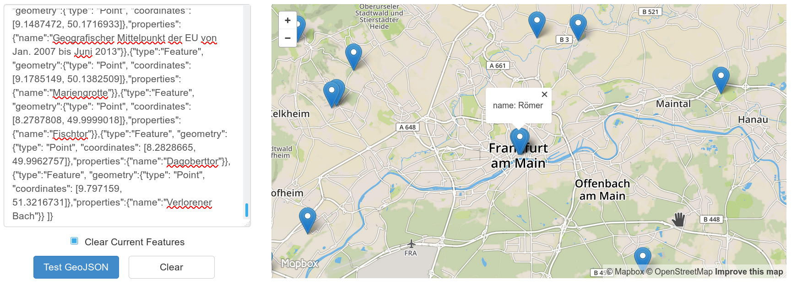
GeoJSON Functions (cont.)
$ mysql osm -B -e "SET NAMES utf8; SET SESSION group_concat_max_len = 10000; SELECT CONCAT('{\"type\":\"FeatureCollection\", \"features\":[ ', GROUP_CONCAT(CONCAT('{\"type\":\"Feature\", \"geometry\":', ST_AsGeoJson(n.coord), ',\"properties\":{\"name\":\"',nm.v,'\"}}')), ' ]}') FROM node_tags n_t JOIN nodes n USING (node_id, version) JOIN node_tags nm USING (node_id, version) WHERE n_t.k='tourism' and n_t.v='attraction' AND nm.k='name'"
http://geojsonlint.com/
Notes:
./sandboxes/msb_5_7_5/use osm -B -e "SET SESSION group_concat_max_len = 10000; SELECT CONCAT('{\"type\":\"FeatureCollection\", \"features\":[ ', GROUP_CONCAT(CONCAT('{\"type\":\"Feature\", \"geometry\":', ST_AsGeoJson(n.coord), ',\"properties\":{\"name\":\"',nm.v,'\"}}')), ' ]}') FROM node_tags n_t JOIN nodes n USING (node_id, version) JOIN node_tags nm USING (node_id, version) WHERE n_t.k='tourism' and n_t.v='attraction' AND nm.k='name'"

Slide 190
Older Issues
Before MySQL 8.0, SRID could be set and retrieved, but all operations were done in squared euclidean coordinates:
mysql-5.7.5 (osm) > SET @p1 := GeomFromText('POINT(8 50)', 4326);
Query OK, 0 rows affected (0.00 sec)
mysql-5.7.5 (osm) > SET @p2 := GeomFromText('POINT(7 50)', 4326);
Query OK, 0 rows affected (0.00 sec)
mysql-5.7.5 (osm) > SET @p3 := GeomFromText('POINT(8 51)', 4326);
Query OK, 0 rows affected (0.00 sec)
mysql-5.7.5 (osm) > SELECT srid(@p1);
+-----------+
| srid(@p1) |
+-----------+
| 4326 |
+-----------+
1 row in set (0.00 sec)
mysql-5.7.5 (osm) > SELECT st_distance(@p1, @p2);
+-----------------------+
| st_distance(@p1, @p2) |
+-----------------------+
| 1 |
+-----------------------+
1 row in set (0.00 sec)
mysql-5.7.5 (osm) > SELECT st_distance(@p1, @p3);
+-----------------------+
| st_distance(@p1, @p3) |
+-----------------------+
| 1 |
+-----------------------+
1 row in set (0.00 sec)
Notes:
Last time heard, the Earth was not flat !?

Slide 191
New 8.0 SRID Support !
mysql-8.0 (osm) > SET @p1 := ST_GeomFromText('POINT(8 50)', 4326);
Query OK, 0 rows affected (0.00 sec)
mysql-8.0 (osm) > SET @p2 := ST_GeomFromText('POINT(7 50)', 4326);
Query OK, 0 rows affected (0.00 sec)
mysql-8.0 (osm) > SET @p3 := ST_GeomFromText('POINT(8 51)', 4326);
Query OK, 0 rows affected (0.00 sec)
mysql-8.0 (osm) > SELECT ST_srid(@p1);
+--------------+
| ST_srid(@p1) |
+--------------+
| 4326 |
+--------------+
1 row in set (0.00 sec)
mysql-8.0 (osm) > SELECT st_distance(@p1, @p2);
+-----------------------+
| st_distance(@p1, @p2) |
+-----------------------+
| 110243.2689139409 |
+-----------------------+
1 row in set (0.00 sec)
mysql-8.0 (osm) > SELECT st_distance(@p1, @p3);
+-----------------------+
| st_distance(@p1, @p3) |
+-----------------------+
| 110592.12831394037 |
+-----------------------+
1 row in set (0.01 sec)
Answers in meters- The world is no longer flat!
I expected something around 71-72 Km, did I do something wrong?
Notes:
Last time heard, the Earth was not flat !?

Slide 192
JSON Native Data Type
Since 5.7.8, MySQL allows columns defined with the JSON data type:
mysql-8.0 > CREATE TABLE json_test(id int PRIMARY KEY auto_increment, content JSON);
Query OK, 0 rows affected (0.03 sec)
mysql-8.0 > INSERT INTO json_test (content) VALUES ('{"type": "correct_json"}');
Query OK, 1 row affected (0.00 sec)
mysql-8.0 > INSERT INTO json_test (content) VALUES ('{"type": "incorrect_json}');
ERROR 3140 (22032): Invalid JSON text: "Missing a closing quotation mark in string." at position 24 in value (or column) '{"type": "incorrect_json}'.
MariaDB supports it only as a BLOB/LONGTEXT alias
They get validated on insert

Slide 193
JSON functions
MySQL includes almost all functions to manipulate JSON that you may think of:
  Validation test: JSON_TYPE
  Object creation: JSON_ARRAY, JSON_MERGE, ...
  Searching: JSON_EXTRACT
  Modifying: JSON_SET, JSON_INSERT, ...

Slide 194
Indexing JSON
JSON Columns cannot be indexed:
mysql [localhost] {msandbox} (test) > ALTER TABLE json_test ADD INDEX(content);
ERROR 3152 (42000): JSON column 'content' cannot be used in key specification.
However, they can be compared with regular fields and use indexes thanks to virtual columns

Slide 195
Conclusions
Query Optimization with MySQL 8.0 and MariaDB 10.3: The Basics
Notes:
11:40

Slide 196
8.0/10.3 Recently released
They are mature enough to be used in production
Latest release doesn’t have as many new features related to query optimization
  But they have a lot of other features and quality of life improvements
  They also fix long outstanding query performance bugs
  MariaDB also catches up with MySQL in some areas
Notes:
RedHat/Centos 7.0 is not production ready, either.

Slide 197



MySQL 8.0 New Features
MySQL 5.6 seemed Percona Server-inspired
MySQL 5.7 seemed MariaDB-inspired
MySQL 8.0 seems Galera and Oracle DB-inspired
  Competition is always good for consumer
Notes:
As

Slide 198
Modern SQL is now part of MySQL!
Window functions, recursive CTEs:
WITH RECURSIVE cte (cl_from, cl_type) AS
(
SELECT cl_from, cl_type FROM categorylinks WHERE cl_to = 'Database_management_systems' -- starting category
UNION
SELECT categorylinks.cl_from, categorylinks.cl_type FROM cte JOIN page ON cl_from = page_id JOIN categorylinks ON page_title = cl_to WHERE cte.cl_type = 'subcat' -- subcat addition on each iteration
)
SELECT page_title FROM cte JOIN page ON cl_from = page_id WHERE page_namespace = 0 ORDER BY page_title; -- printing only articles in the end, ordered by title
Scan Wikipedia categories, page links recursively!

Slide 199
Many Optimizer Advantages Have to Be Manually Enabled
Modifying on a per-query basis:
SET optimizer_switch='batched_key_access=on';
SET join_cache_level=8; # for MariaDB
in order to take advantage of them, making some of features useless unless you are fine-tuning
  I expect that to change in the future

Slide 200

I Herby Declare MyISAM as Dead
All major MyISAM-only features are now on MySQL 5.7/8.0
  FULLTEXT
  GIS
  Transportable tables
Previous blockers such as grant tables (new InnoDB data dictionary) and temporary tables are now in InnoDB format

Slide 201

Benchmarks
Do not trust first party
benchmarks
  In fact, do not trust 3rd
  party benchmarks either
Only care about the
performance of your
application running on your hardware

Slide 202

Q&A

Slide 203

Not to Miss
Operations track:
TLS for MySQL at Large Scale: How we do relational data on-the-wire encryption at the Wikimedia Foundation
Do you want to do query optimization for a website with 20 Billion views per month?
https://wikimediafoundation.org/about/jobs/

Slide 204
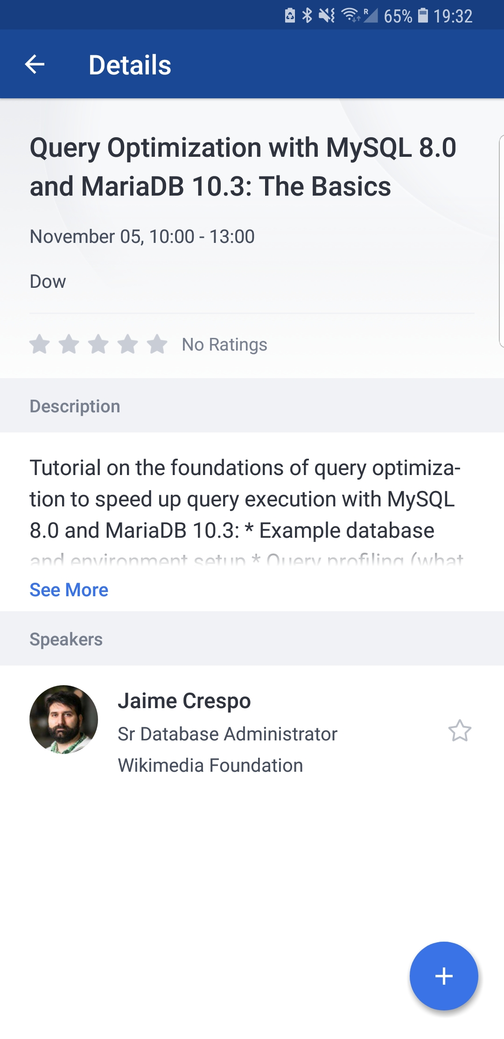
Thank You for Attending!
Do not forget, after the session finishes, to please login with your Percona Live app and “Rate This Session”
Special thanks to in order by rand() to: Ariel Glenn, Manuel Arostegui, Morgan Tocker, Sean Pringle, David Hildebrandt, Bill Karwin, Domas Mituzas, Mark Callaghan, Shlomi Noach, Valerii Kravchuk, Miguel Ángel Nieto, Dimitri Kravtchuk, Olav Sandstå and the whole Wikimedia Team, and all people at the MariaDB, Percona and MySQL/Oracle teams, and the Percona Live Organization and Sponsors
Notes:
I do not get payed by this session, so please rate this session if you liked it!

